Slide 1


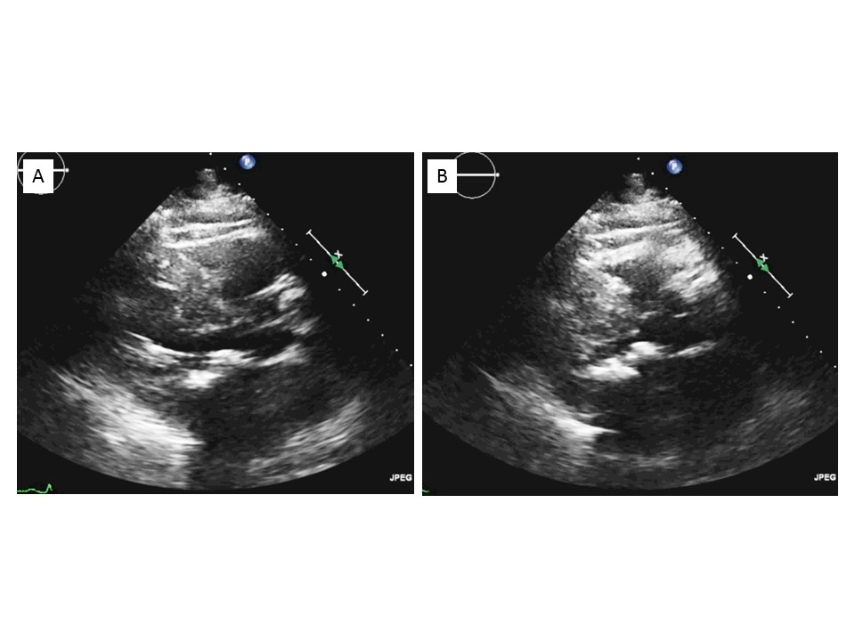

Transcatheter mitral valve implantation (old)
Figure 22
Transthoracic echocardiography, small left ventricular cavity and septal bulge contraindicating transcatheter valve implantation in mitral annulus calcification. A) Diastole. B) Systole.
Mirjam Wild, Maurizio Taramasso, Alison Duncan, Giulio Russo, Dominique Himbert, Francesco Maisano, Nicolo Piazza, Fabien Praz
©2025 Europa Group - All rights reserved.

