Slide 1


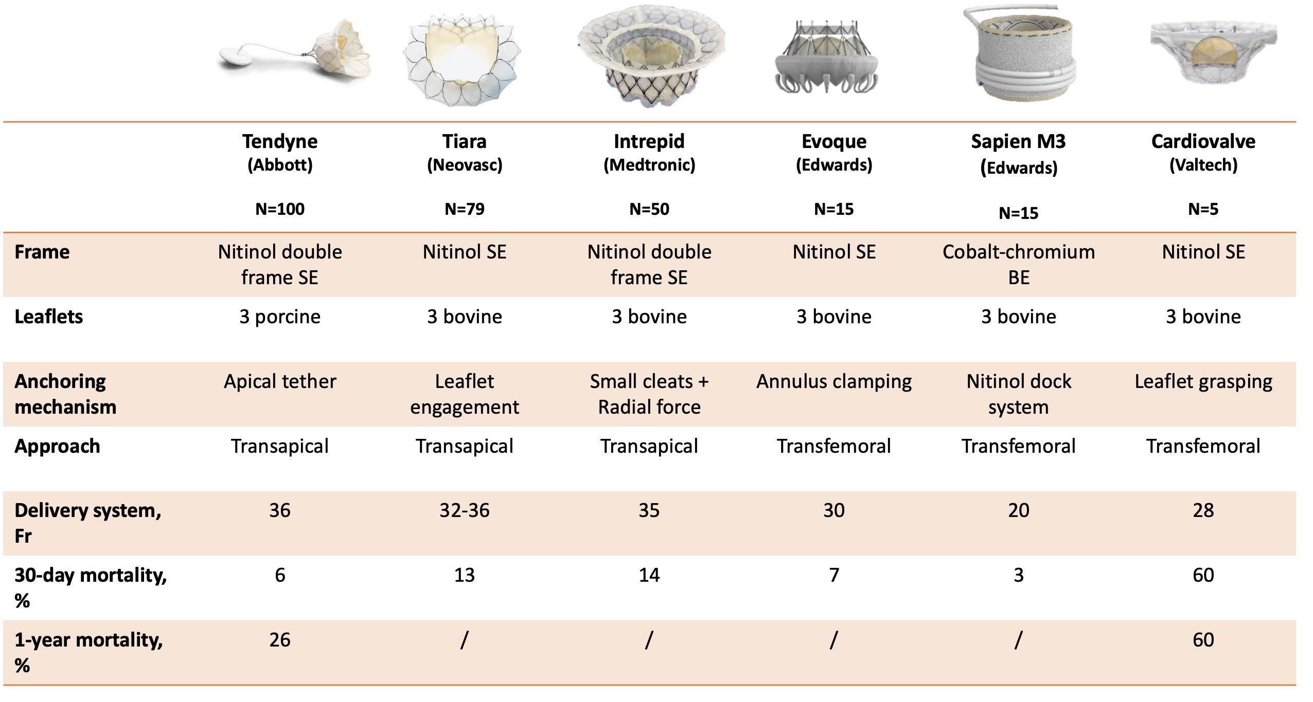

Transcatheter mitral valve implantation (old)
Figure 24
A: Tiara (Neovasc Inc., Richmond, BC, Canada). B: Tendyne (Abbott). C: Evoque (Edwards Lifesciences). D: Intrepid (Medtronic). E: Cardiovalve (Valtech Cardio Ltd, Or Yehuda, Israel ). F: HighLife (HighLife SAS, Paris, France)
Mirjam Wild, Maurizio Taramasso, Alison Duncan, Giulio Russo, Dominique Himbert, Francesco Maisano, Nicolo Piazza, Fabien Praz
©2025 Europa Group - All rights reserved.

