Slide 1


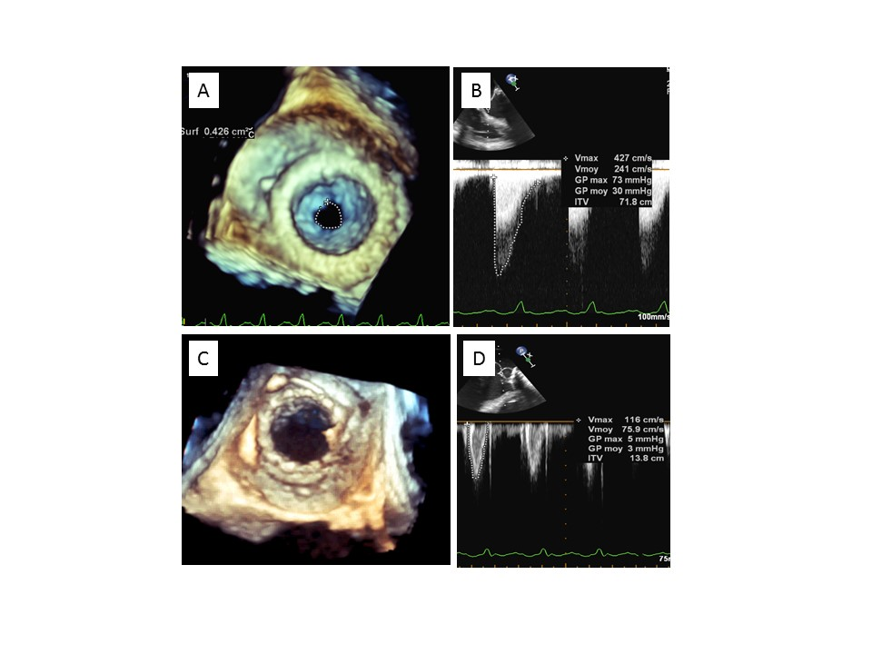

Transcatheter mitral valve implantation (old)
Figure 3
Immediate transoesophageal echocardiographic evaluation after transcatheter mitral valve-in-valve implantation.A) Before implantation: 3D planimetry.B) Before implantation: transprosthetic mitral gradient.C) After implantation: 3D evaluation.D) After implantation: transprosthetic mitral gradient.Figure 4. Multimodality imaging to measure valve inner diameters before transcatheter mitral valve implantation.A) Computed tomography.B) Transoesophageal echocardiography.C) Fluoroscopy.
Mirjam Wild, Maurizio Taramasso, Alison Duncan, Giulio Russo, Dominique Himbert, Francesco Maisano, Nicolo Piazza, Fabien Praz
©2025 Europa Group - All rights reserved.

