Slide 1


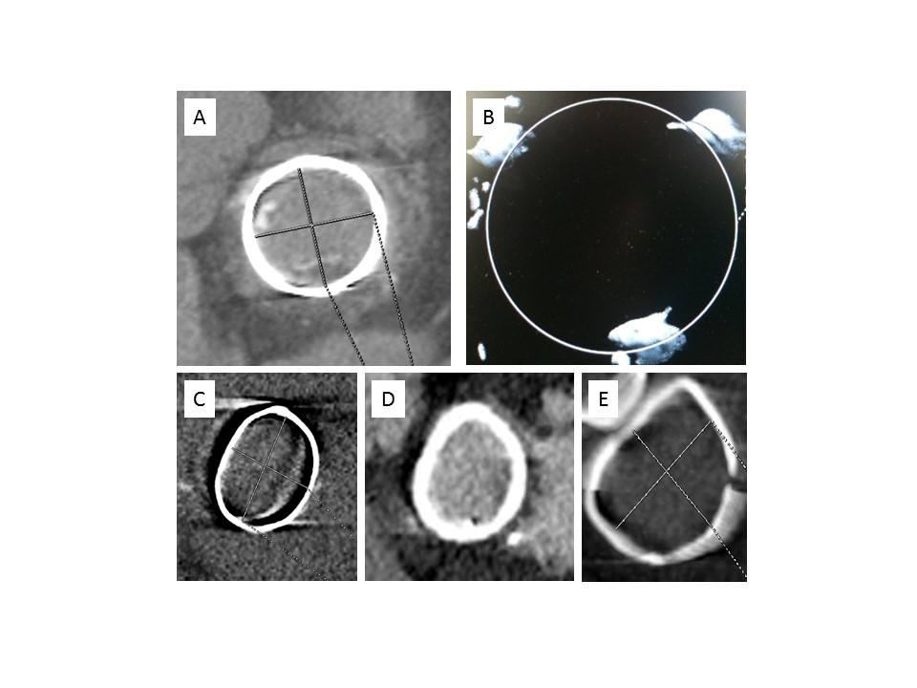

Transcatheter mitral valve implantation (old)
Figure 5
Computed tomography, various brands of surgical valves and rings commonly used. A) PERIMOUNT valve: radiopaque ring, easy measurement of the inner diameter.B) Mosaic valve: radiolucent ring, only three dots visible on the top of the frame.C) Physio: semi-flexible ring.D) Séguin: rigid ring. E) Duran: flexible ring.
Mirjam Wild, Maurizio Taramasso, Alison Duncan, Giulio Russo, Dominique Himbert, Francesco Maisano, Nicolo Piazza, Fabien Praz
©2025 Europa Group - All rights reserved.

