Slide 1


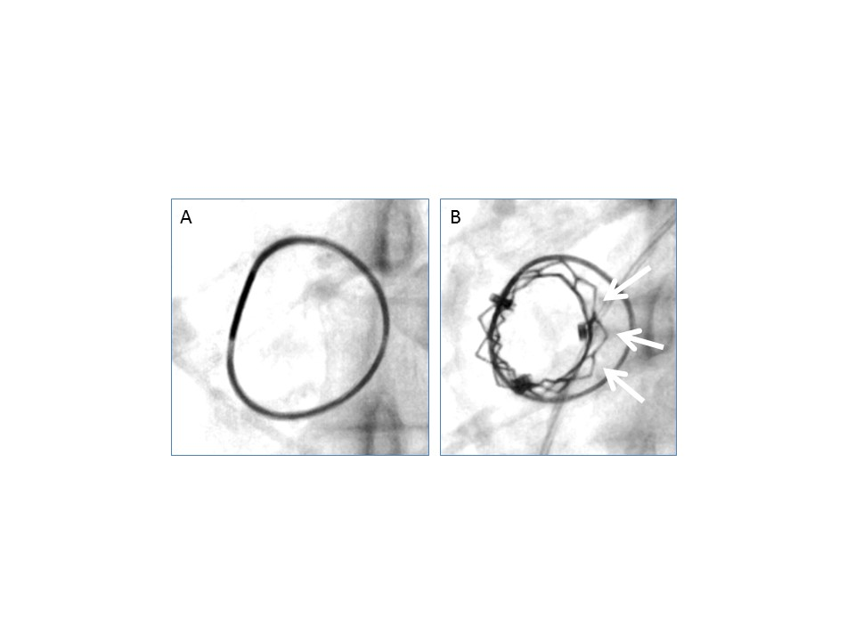

Transcatheter mitral valve implantation (old)
Figure 6
Fluoroscopy, severely stenotic mitral Physio ring.A) Pre implantation.B) Post implantation. The arrows show a large gap between the ring and the transcatheter valve, due to the presence of a large amount of valvular tissue in the context of severe mitral stenosis.
Mirjam Wild, Maurizio Taramasso, Alison Duncan, Giulio Russo, Dominique Himbert, Francesco Maisano, Nicolo Piazza, Fabien Praz
©2025 Europa Group - All rights reserved.

