Slide 1


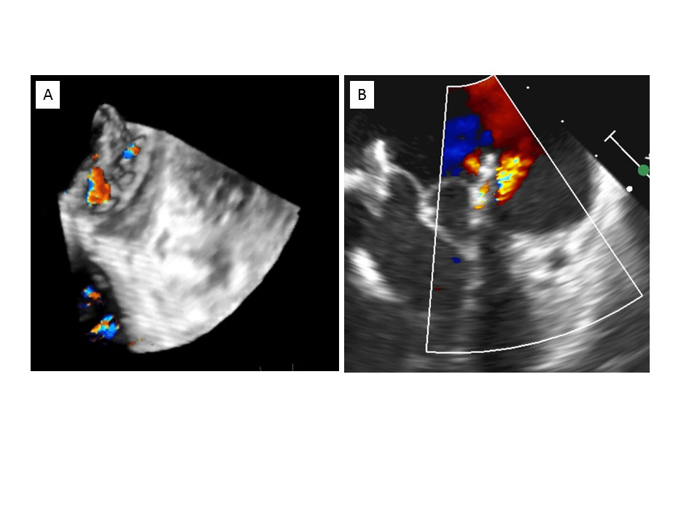

Transcatheter mitral valve implantation (old)
Figure 7
Transoesophageal echocardiography, paravalvular leak after valve-in-ring implantation.A) 3D imaging showing mitral regurgitation with two jets localised within a gap between the surgical ring and the transcatheter valve.B) 2D imaging.
Mirjam Wild, Maurizio Taramasso, Alison Duncan, Giulio Russo, Dominique Himbert, Francesco Maisano, Nicolo Piazza, Fabien Praz
©2025 Europa Group - All rights reserved.

