Slide 1


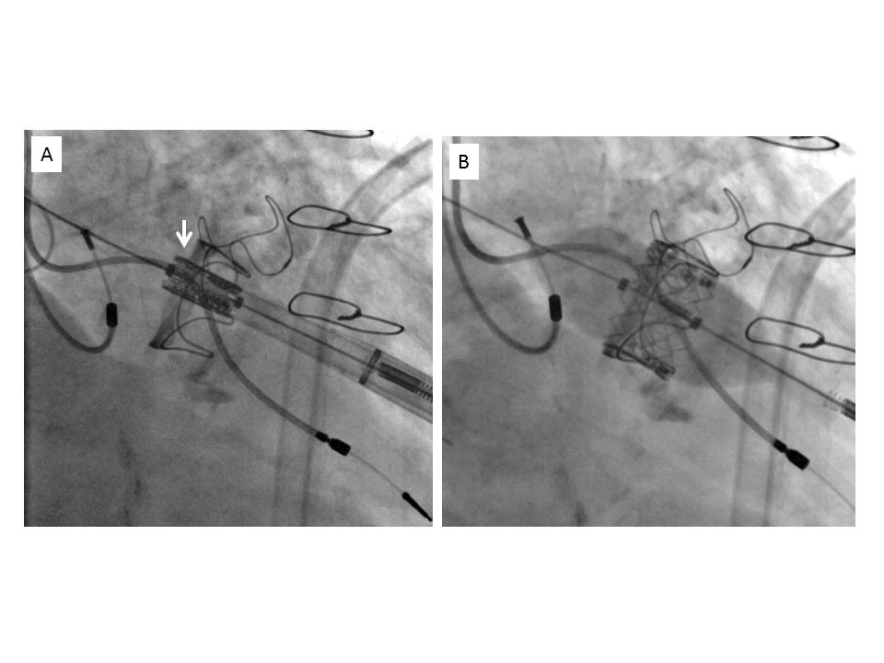

Transcatheter mitral valve implantation (old)
Figure 8
Transapical implantation of a SAPIEN XT valve in a PERIMOUNT mitral valve.A) Positioning of the valve, with an overlap of 2 mm towards the left atrium (arrow).B) Deployment of the valve in the appropriate position.
Mirjam Wild, Maurizio Taramasso, Alison Duncan, Giulio Russo, Dominique Himbert, Francesco Maisano, Nicolo Piazza, Fabien Praz
©2025 Europa Group - All rights reserved.

