Slide 1


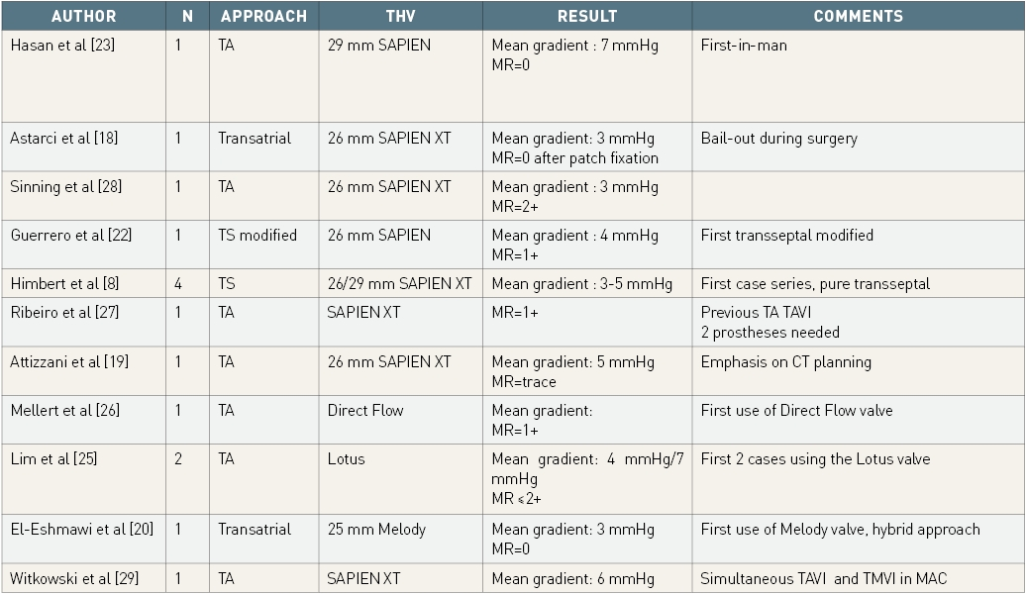

Transcatheter mitral valve implantation (old)
Table 1
Published case reports of TAVI valve implantation in MAC.MAC: mitral annulus calcification; TA: transapical; TAVI: transcatheter aortic valve implantation; THV: transcatheter heart valve; TMVI: transcatheter mitral valve implantation; TS: transseptal
Mirjam Wild, Maurizio Taramasso, Alison Duncan, Giulio Russo, Dominique Himbert, Francesco Maisano, Nicolo Piazza, Fabien Praz
©2025 Europa Group - All rights reserved.

