Slide 1


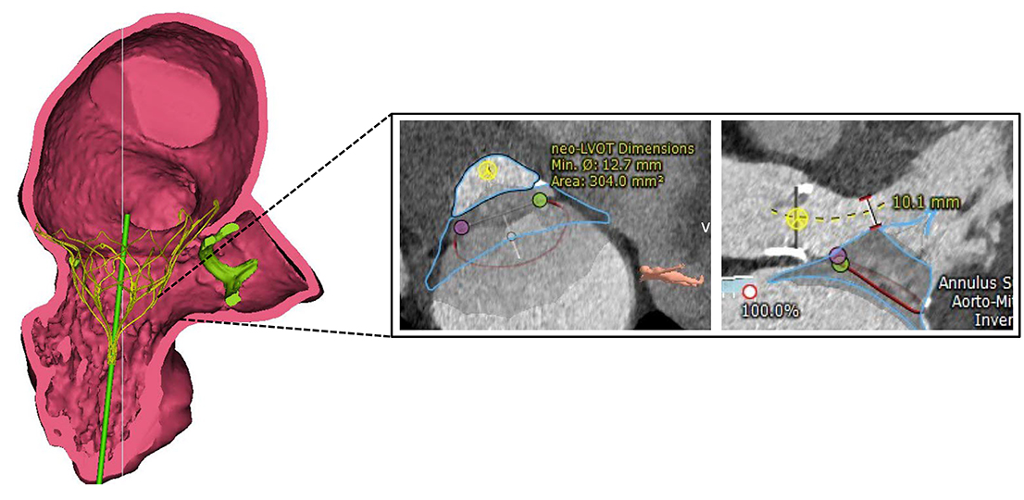

Transcatheter mitral valve implantation
Figure 1
Three-dimensional valve simulation using computed tomography. Virtual implantation of a Tendyne prosthesis (Abbott) with measurement of the anticipated Neo-LVOT (left ventricular outflow tract) during systole.
Mirjam Wild, Maurizio Taramasso, Alison Duncan, Giulio Russo, Dominique Himbert, Francesco Maisano, Nicolo Piazza, Fabien Praz
©2025 Europa Group - All rights reserved.

