Slide 1


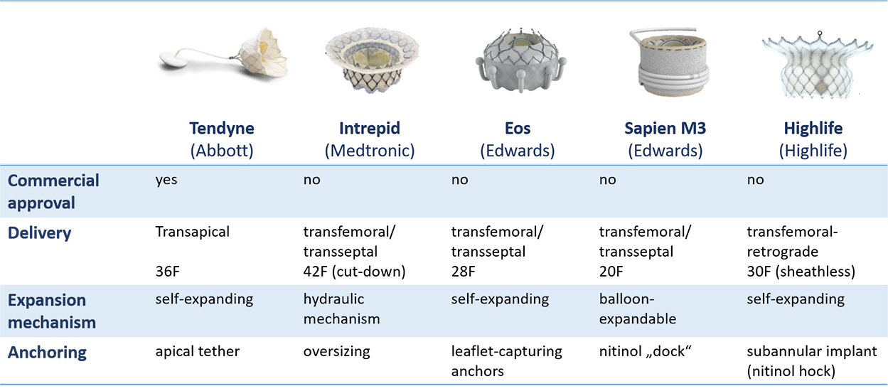

Transcatheter mitral valve implantation
Figure 2
Approved and emerging devices for transcatheter mitral valve implantation (TMVI) in the native mitral valve.
Mirjam Wild, Maurizio Taramasso, Alison Duncan, Giulio Russo, Dominique Himbert, Francesco Maisano, Nicolo Piazza, Fabien Praz
©2025 Europa Group - All rights reserved.

