Slide 1


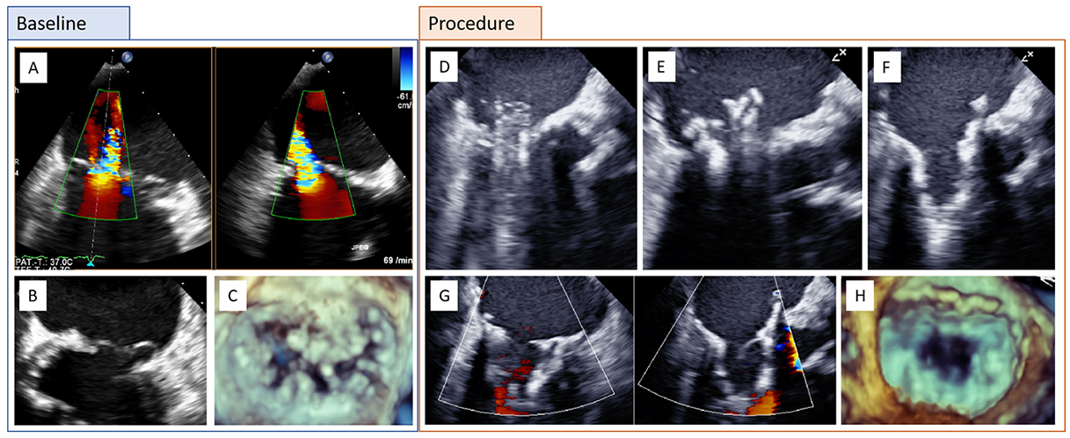

Transcatheter mitral valve implantation
Figure 3
Clinical case of a patient with complex primary mitral regurgitation (MR) treated by transcatheter mitral valve implantation (TMVI) with a Tendyne bioprosthesis. A) Baseline transesophageal echocardiography (TEE color Doppler; biplane) with severe MR. B) Bileaflet prolapse and annular calcification. C) Three-dimensional (3D) echocardiography. D) TMVI procedure with advancement of the delivery catheter into the left atrium and E-F) stepwise deployment of the Tendyne prosthesis. G-H) Assessment of the final result by biplane TEE with color Doppler and 3D.
Mirjam Wild, Maurizio Taramasso, Alison Duncan, Giulio Russo, Dominique Himbert, Francesco Maisano, Nicolo Piazza, Fabien Praz
©2025 Europa Group - All rights reserved.

