Slide 1


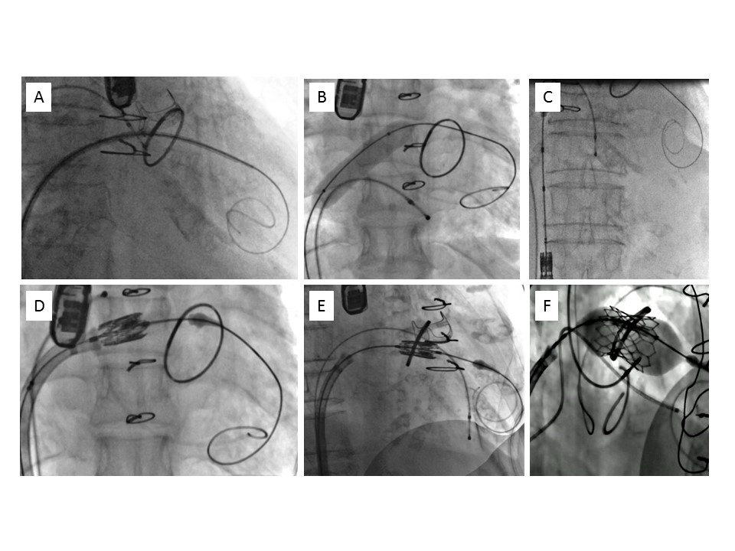

Transcatheter mitral valve implantation
Figure 4
Transvenous, transseptal mitral valve-in-ring implantation. A) Guidewire placement at the apex of the left ventricle. B) Dilatation of the intratrial septum. C) Loading of the valve prosthesis in the inferior vena cava. D) Crossing of the interatrial septum using delivery catheter flex. E) Positioning in the mitral ring in a perpendicular plane. F) Valve deployment by progressive balloon inflation under rapid pacing.
Mirjam Wild, Maurizio Taramasso, Alison Duncan, Giulio Russo, Dominique Himbert, Francesco Maisano, Nicolo Piazza, Fabien Praz
©2025 Europa Group - All rights reserved.

