Slide 1


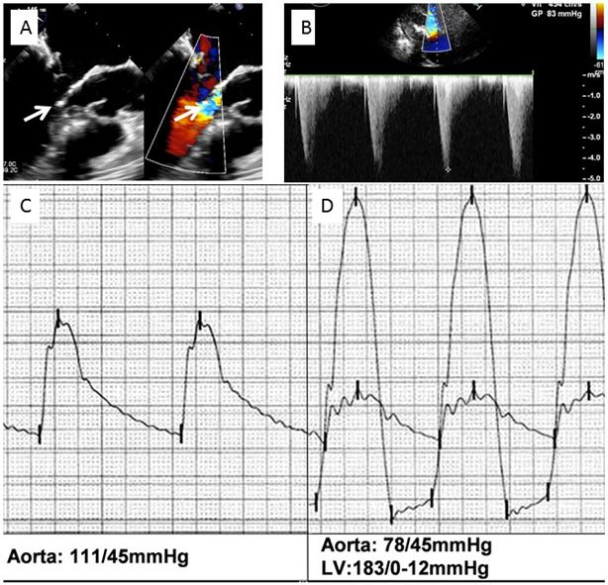

Transcatheter mitral valve implantation
Figure 5
Left ventricular outflow tract obstruction after transcatheter implantation of a SAPIEN XT valve in a mitral annulus calcification. A) 2D transoesophageal echocardiography, long-axis view; contact between the subvalvular mitral apparatus and the septal bulge (left arrow) and aliasing in the left ventricular outflow tract (right arrow). B) Increased gradient in the left ventricular outflow tract. C) Aortic pressure before implantation. D) Severe hypotension with 105 mmHg ventriculo-aortic peak to peak gradient post implantation.
Mirjam Wild, Maurizio Taramasso, Alison Duncan, Giulio Russo, Dominique Himbert, Francesco Maisano, Nicolo Piazza, Fabien Praz
©2025 Europa Group - All rights reserved.

