Slide 1


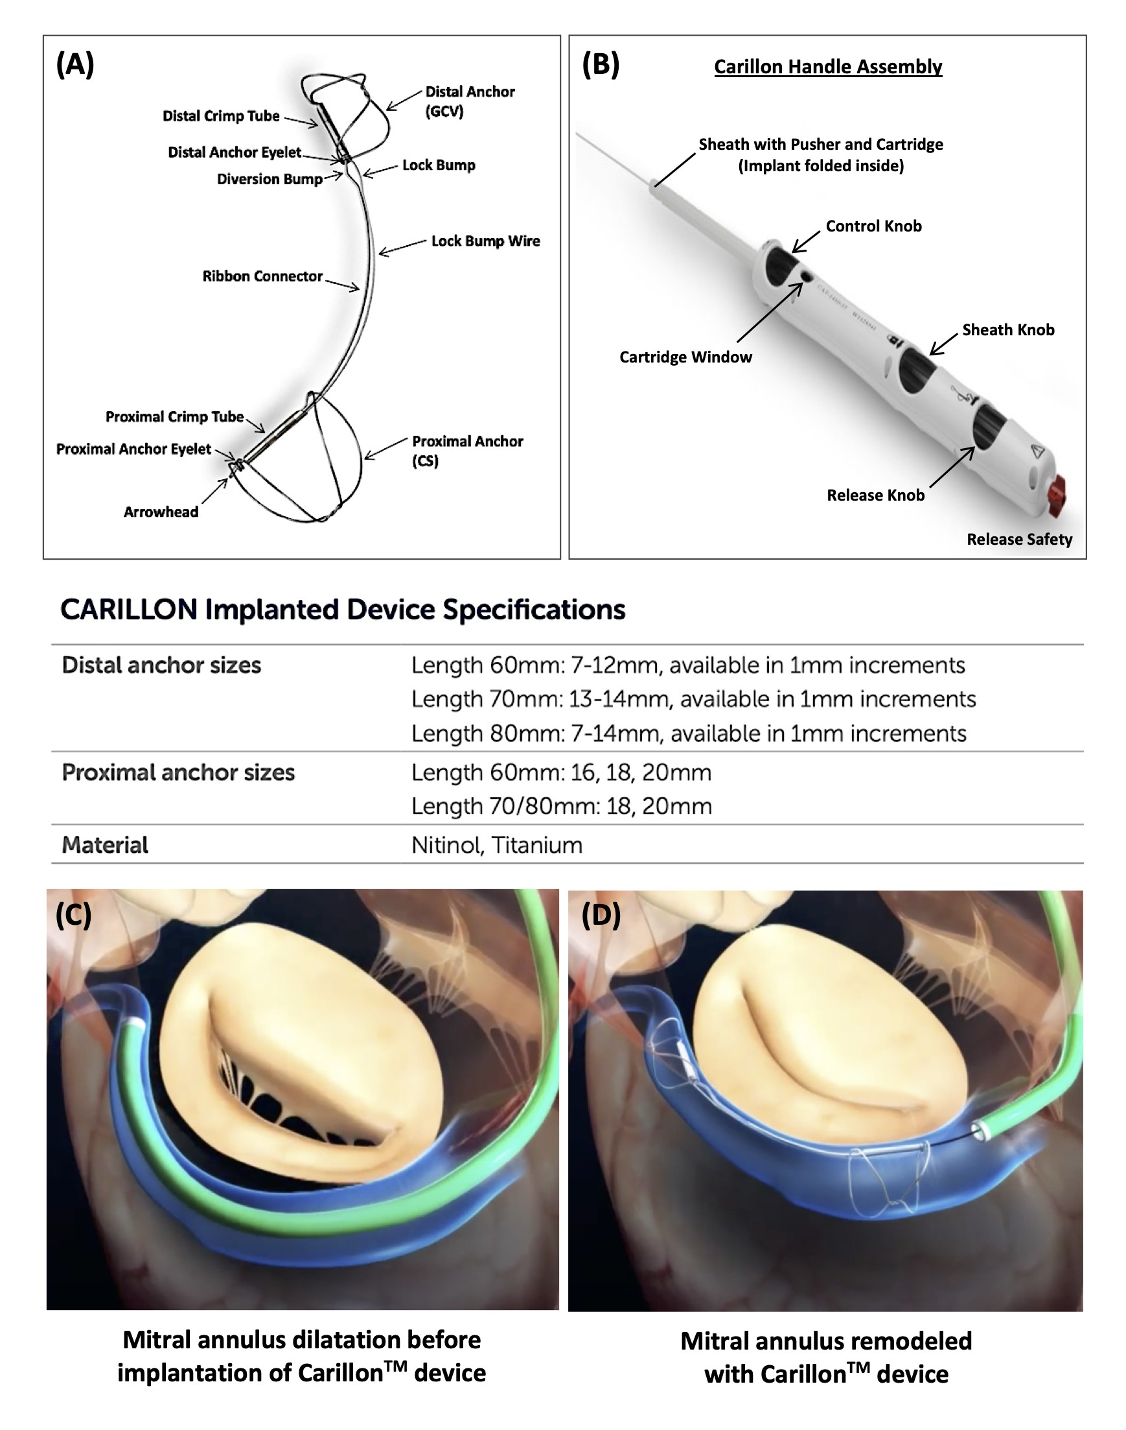

Transcatheter mitral valve repair
Figure 1
CarillonTM Mitral Contour SystemTM. (A) Components of the CarillonTM implanted device – the distal and proximal anchor are implanted in the great cardiac vein (GCV) and coronary sinus (CS), respectively. (B) Components of the Carillon Handle Assembly. (C-D) The REDUCE-FMR (Carillon Mitral Contour System for Reducing Functional Mitral Regurgitation) trial was a randomized, placebo-controlled, double-blind, proof-of-concept study that demonstrated significant reduction in mitral regurgitation as well as reverse remodeling at 1 year in a comparison between the CarillonTM Mitral Contour SystemTM and a sham procedure. Images courtesy of and provided by Cardiac Dimensions Inc.
Olaf W. Franzen, Ole De Backer, Mirjam Wild, Lars Sondergaard
©2025 Europa Group - All rights reserved.

