Slide 1


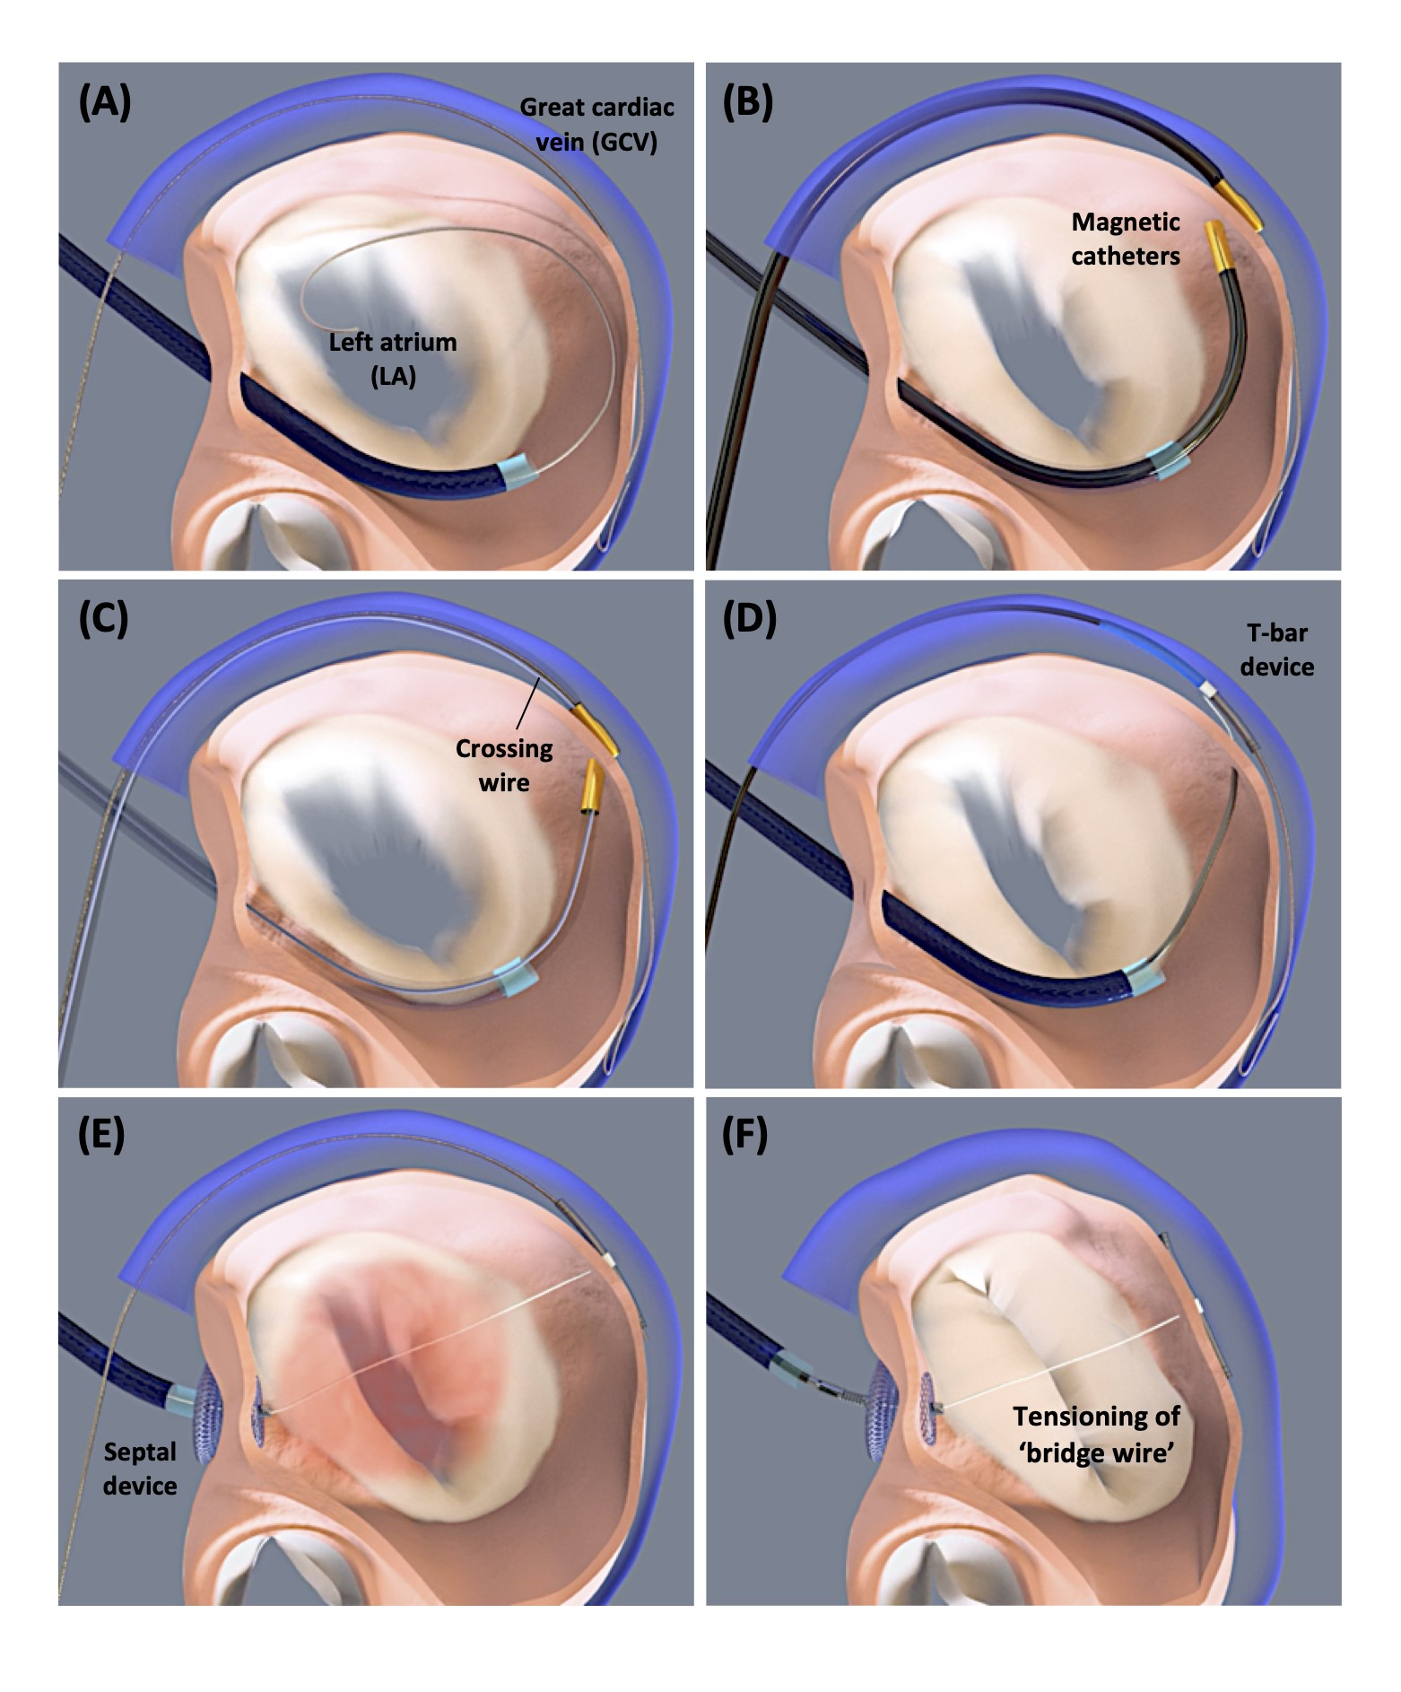

Transcatheter mitral valve repair
Figure 2
ARTOTM implantation steps. (A) Insertion of a guide wire in the great cardiac vein (GCV) via the right jugular vein and transseptal insertion of a guide wire and 12 Fr sheath into the left atrium (LA). (B) Insertion of GCV and LA magnetic catheters, which should connect at the side of the posterior mitral leaflet. (C) Insertion of the crossing wire from GCV to LA side through the magnetic catheters. (D) Following removal of the magnetic catheters and exchanging the crossing wire with the bridge-extension wire, implantation of the T-bar device in the lateral wall via the GCV. (E) Next, implantation of the septal device. (F) Tensioning of the ‘bridge wire’ between the T-bar in the GCV and septal anchor, resulting in shortening of the mitral annulus anterior-posterior diameter and MR reduction. Once the final position is achieved, the suture is cut and secured with a suture lock. The procedure is performed under general anesthesia and requires intraprocedural transesophageal echocardiography (TEE) guidance. Images courtesy of and provided by MVRx Inc.
Olaf W. Franzen, Ole De Backer, Mirjam Wild, Lars Sondergaard
©2025 Europa Group - All rights reserved.

