Slide 1


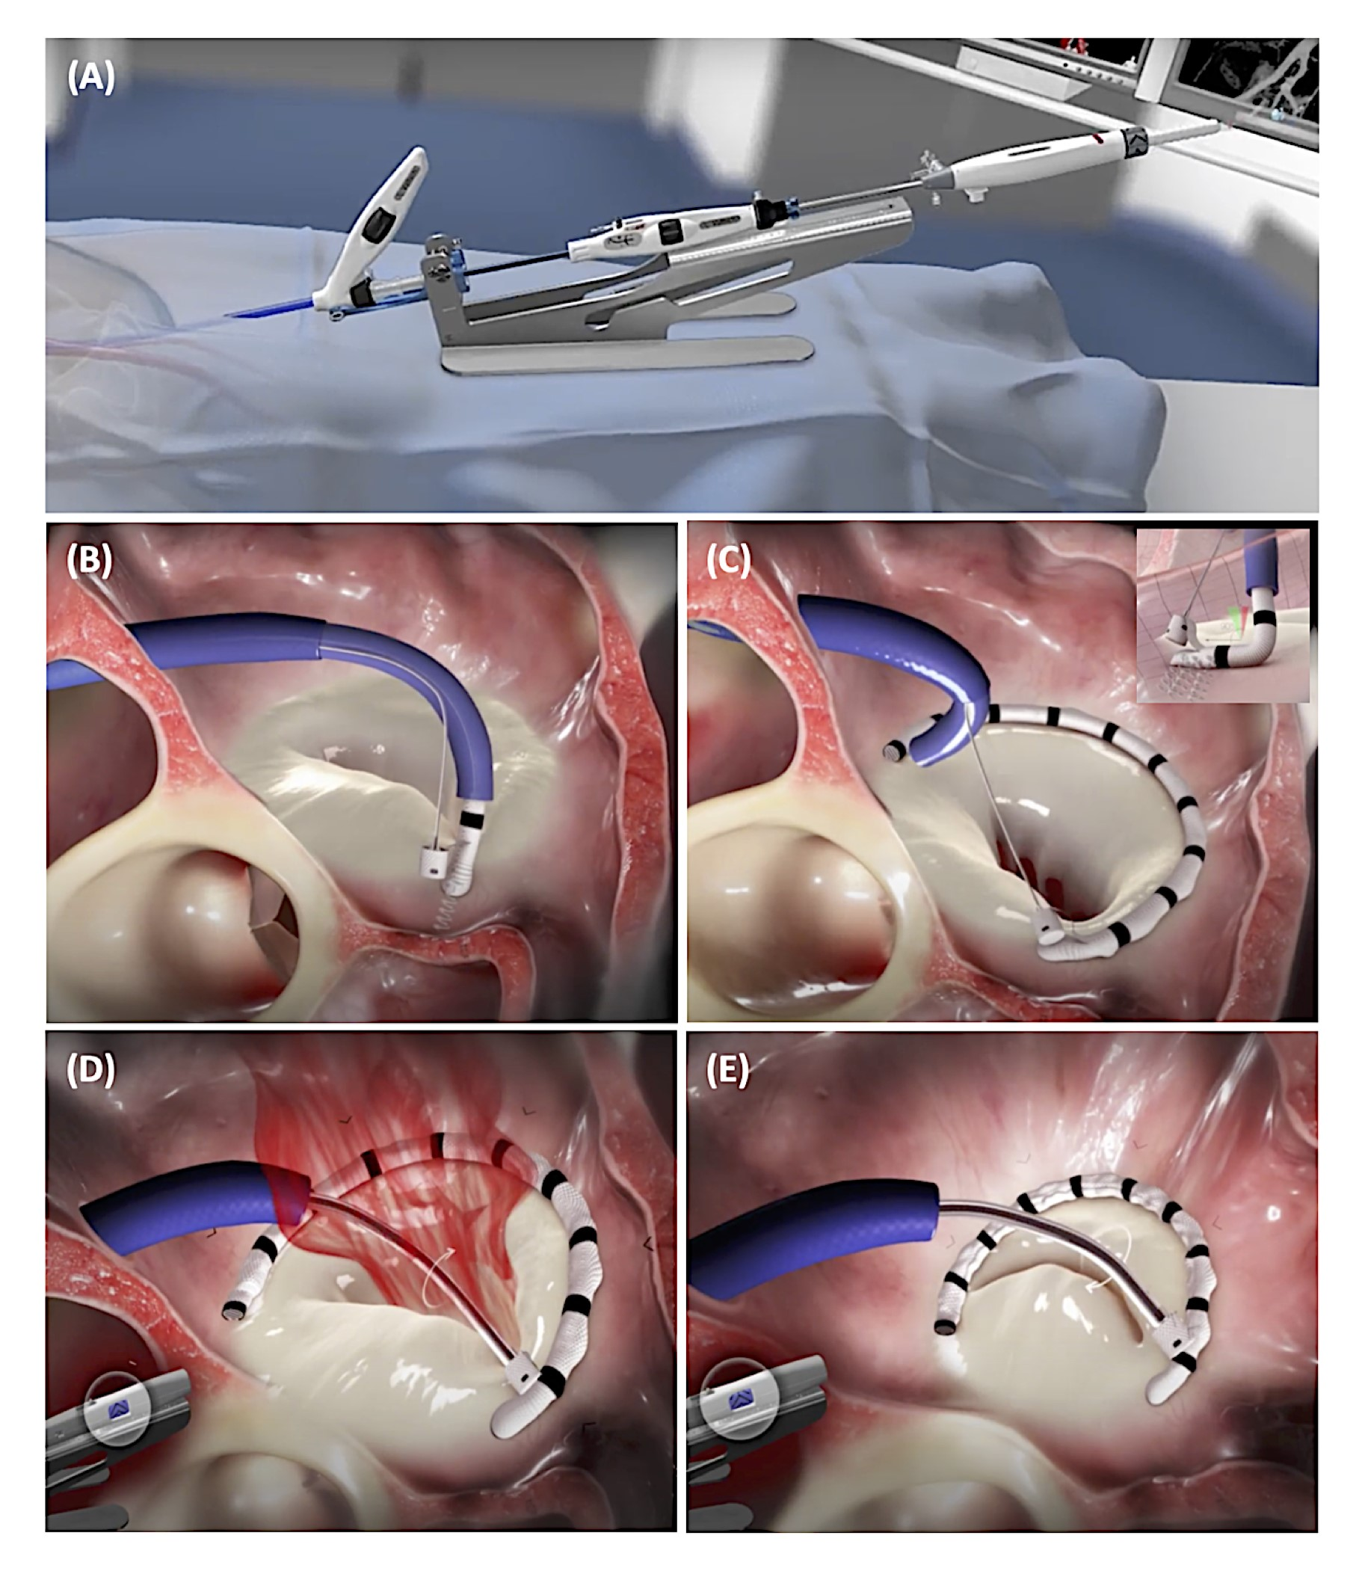

Transcatheter mitral valve repair
Figure 3
Cardioband Mitral System. (A) The Cardioband delivery system. (B) Correct positioning of the first anchor at the anterior and lateral side of the mitral annulus. (C) The anchors are repeatedly placed at the mitral annulus – covered by the polyester sleeve – until the implant catheter tip reaches the last anchoring site at the medial side. (D-E) Cinching of the Cardioband device, resulting in a reduction of the mitral annular diameter and MR severity. Images courtesy of and provided by Edwards Lifesciences.
Olaf W. Franzen, Ole De Backer, Mirjam Wild, Lars Sondergaard
©2025 Europa Group - All rights reserved.

