Slide 1


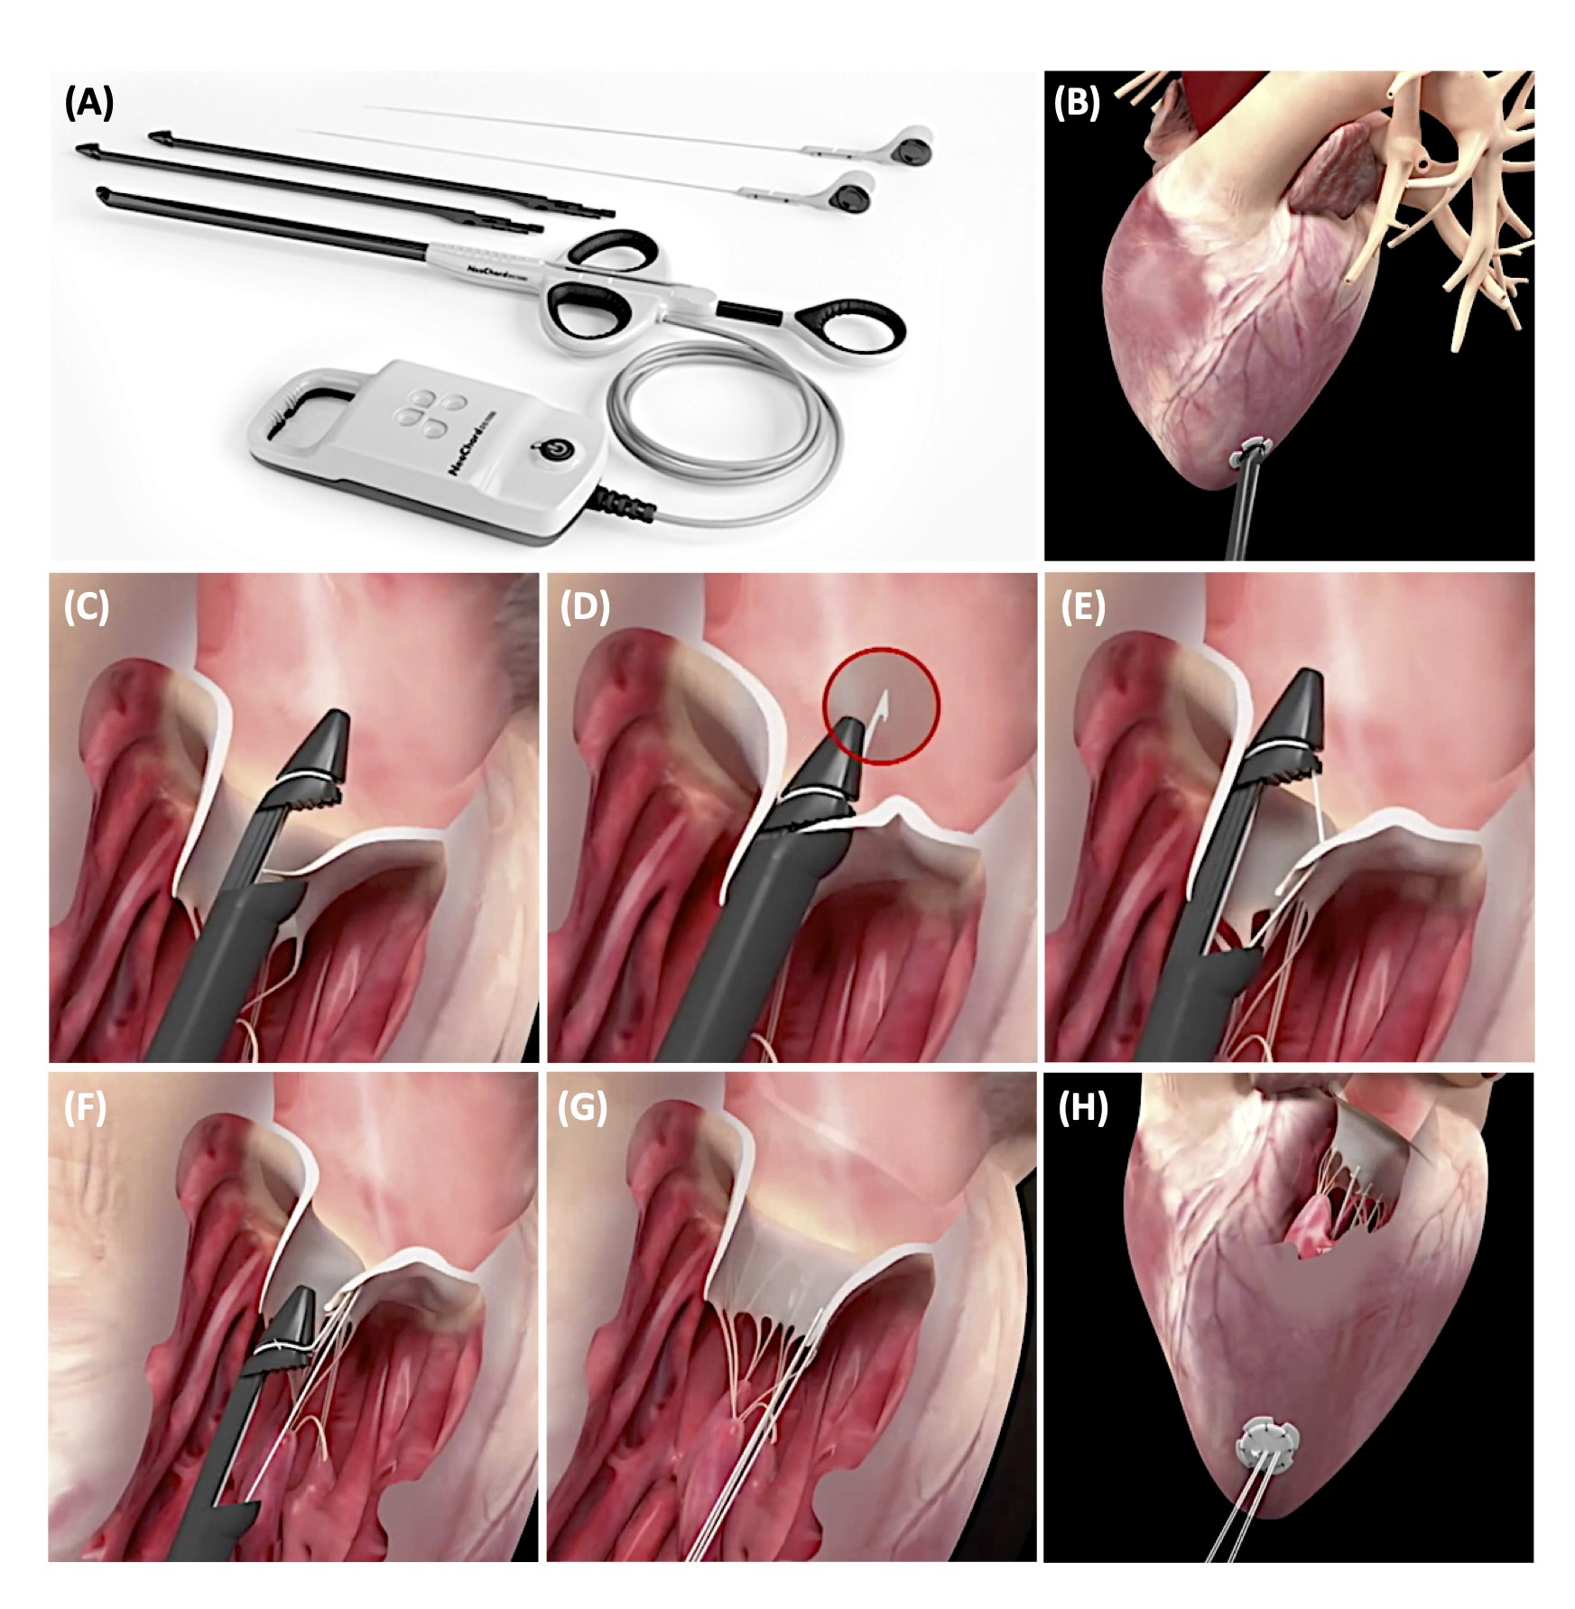

Transcatheter mitral valve repair
Figure 9
NeoChordTM Transcatheter Mitral Valve Repair.
(A) Components of the NeoChordTM system. (B) NeoChordTM is a transapical, beating heart, off-pump mitral valve repair system. (C) The jaws of the device are opened and the leaflet edge is grasped by withdrawing the device from the left atrium. (D-E) A loop of the suture and a girth hitch knot can be formed through the mitral leaflet. (F-G) The length of each neo-chordae can be adjusted to achieve maximal MR reduction under normal LV filling conditions as assessed by TEE. (H) Each of the neo-chordae is tied to the LV epicardial pledget. Images courtesy of and provided by NeoChord Inc.
Olaf W. Franzen, Ole De Backer, Mirjam Wild, Lars Sondergaard
©2025 Europa Group - All rights reserved.

