Slide 1


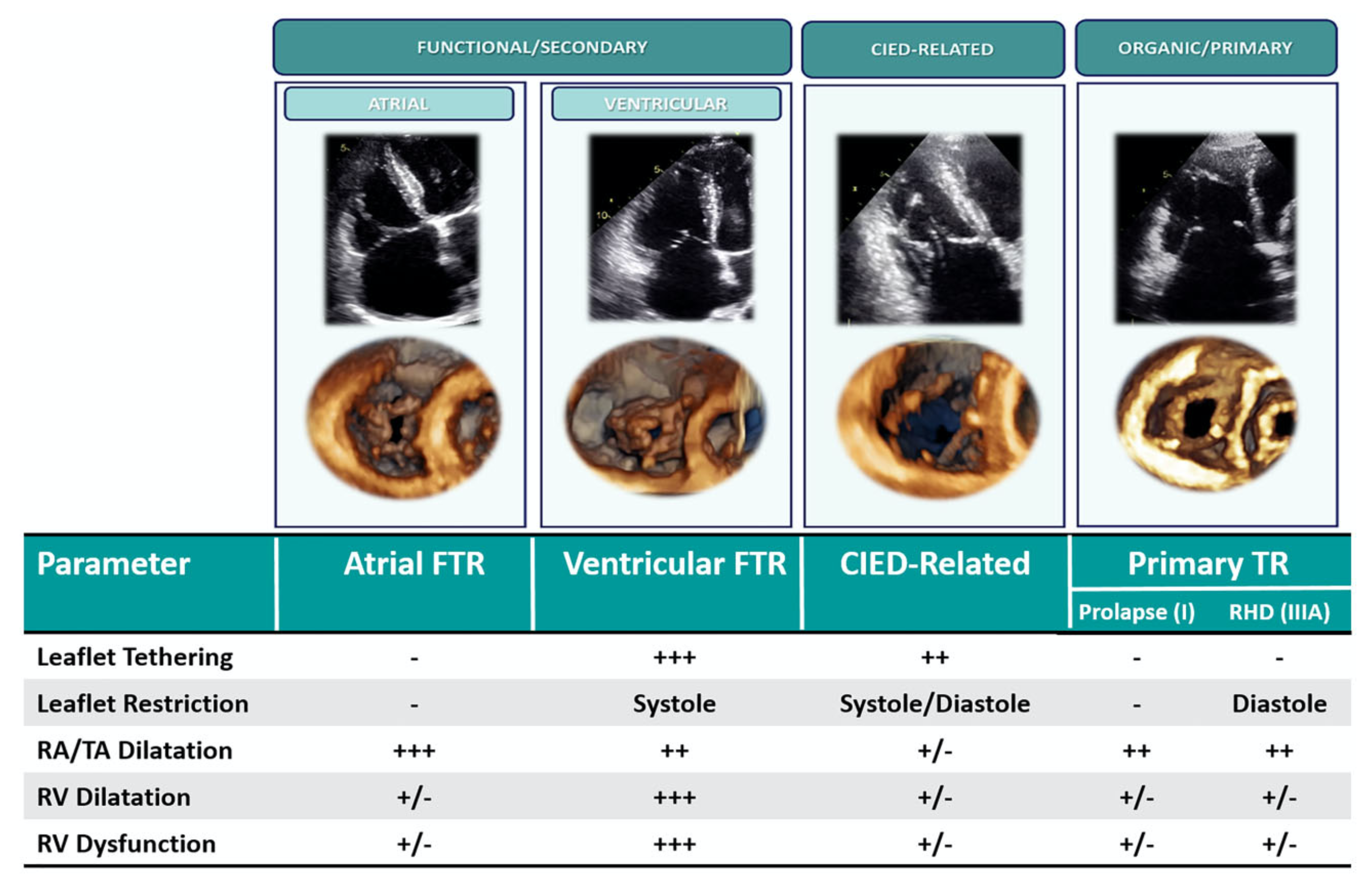

Transcatheter tricuspid valve interventions
Figure 1
Classification of TR. Primary TR: organic disease of valve leaflets is present (prolapse, rheumatic disease, endocarditis, other). The right atrium is dilated; the right ventricle can be dilated and/or failing depending on the stage of the disease. Cardiac Implantable Electronic Device Related: interference with a lead causes TR; features of primary and secondary TR can both be present. Secondary (Functional) TR, sub-classified in atrial and ventricular TR. Atrial TR is due to atrial fibrillation causing right atrium and tricuspid annulus dilatation/dysfunction; no severe leaflet tethering nor right ventricle dysfunction are usually present. Ventricular TR is due to left-side heart disease / pulmonary hypertension / right ventricle disease causing right ventricle dilatation and dysfunction; leaflet tethering is typically observed along with significant right ventricle remodeling. Reproduced with permission from Hahn et al. [2].
Nicola Buzzatti, Jean-Michel Juliard, Fabien Praz, Alec Vahanian, Azeem Latib, Eric Brochet, Phalla Ou, Dominique Himbert, Mirjam Wild, Domenico Angellotti
©2025 Europa Group - All rights reserved.

