Slide 1


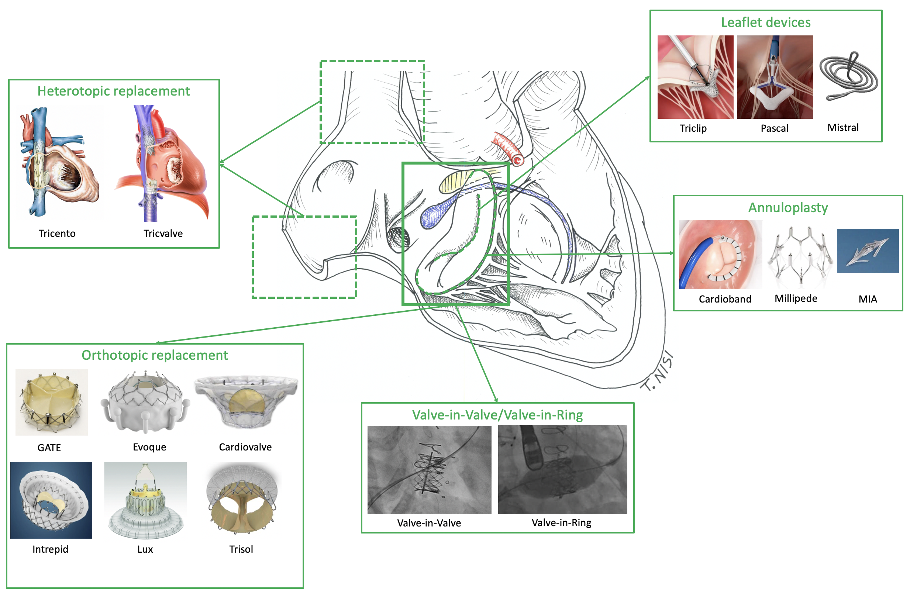

Transcatheter tricuspid valve interventions
Figure 10
Landscape of currently most important transcatheter tricuspid devices. Among the tricuspid surrounding structures, the conduction system is highlightened in blue, the membranous septum in yellow and the right coronary artery in red.
Nicola Buzzatti, Jean-Michel Juliard, Fabien Praz, Alec Vahanian, Azeem Latib, Eric Brochet, Phalla Ou, Dominique Himbert, Mirjam Wild, Domenico Angellotti
©2025 Europa Group - All rights reserved.

