Slide 1


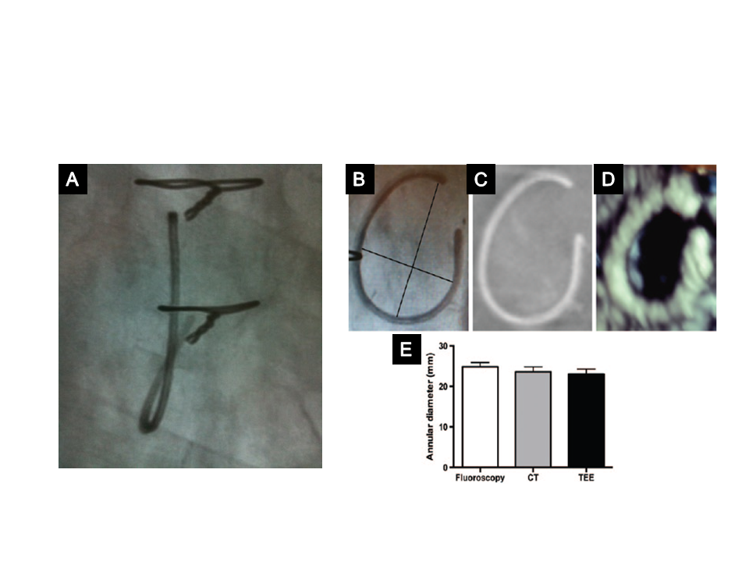

Transcatheter tricuspid valve interventions
Figure 11
Typical tricuspid annuloplasty ring.
A) Fluoroscopic view of a tricuspid ring showing that it is non-circular, open and non-planar. B) - D) Measurement of the inner diameter of an annuloplasty ring, showing the long and short axis (black lines) taken into account to measure the inner diameter (B), 3D TOE (C), and CT scan (D). Mean inner diameter measurements using the three methods (E).
Nicola Buzzatti, Jean-Michel Juliard, Fabien Praz, Alec Vahanian, Azeem Latib,
Eric Brochet, Phalla Ou, Dominique Himbert, Mirjam Wild, Domenico Angellotti
©2025 Europa Group - All rights reserved.

