Slide 1


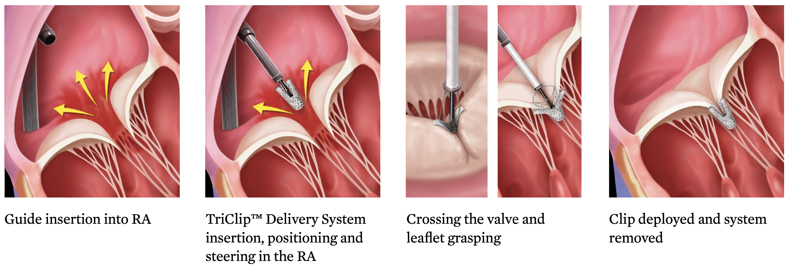

Transcatheter tricuspid valve interventions
Figure 12
The Triclip device is the most used transcatheter tricuspid therapy in the world. Clip arms and grippers capture the tricuspid leaflets, closure of the clip force leaflet coaptation. Four different clip sizes are currently available.
Nicola Buzzatti, Jean-Michel Juliard, Fabien Praz, Alec Vahanian, Azeem Latib, Eric Brochet, Phalla Ou, Dominique Himbert, Mirjam Wild, Domenico Angellotti
©2025 Europa Group - All rights reserved.

