Slide 1


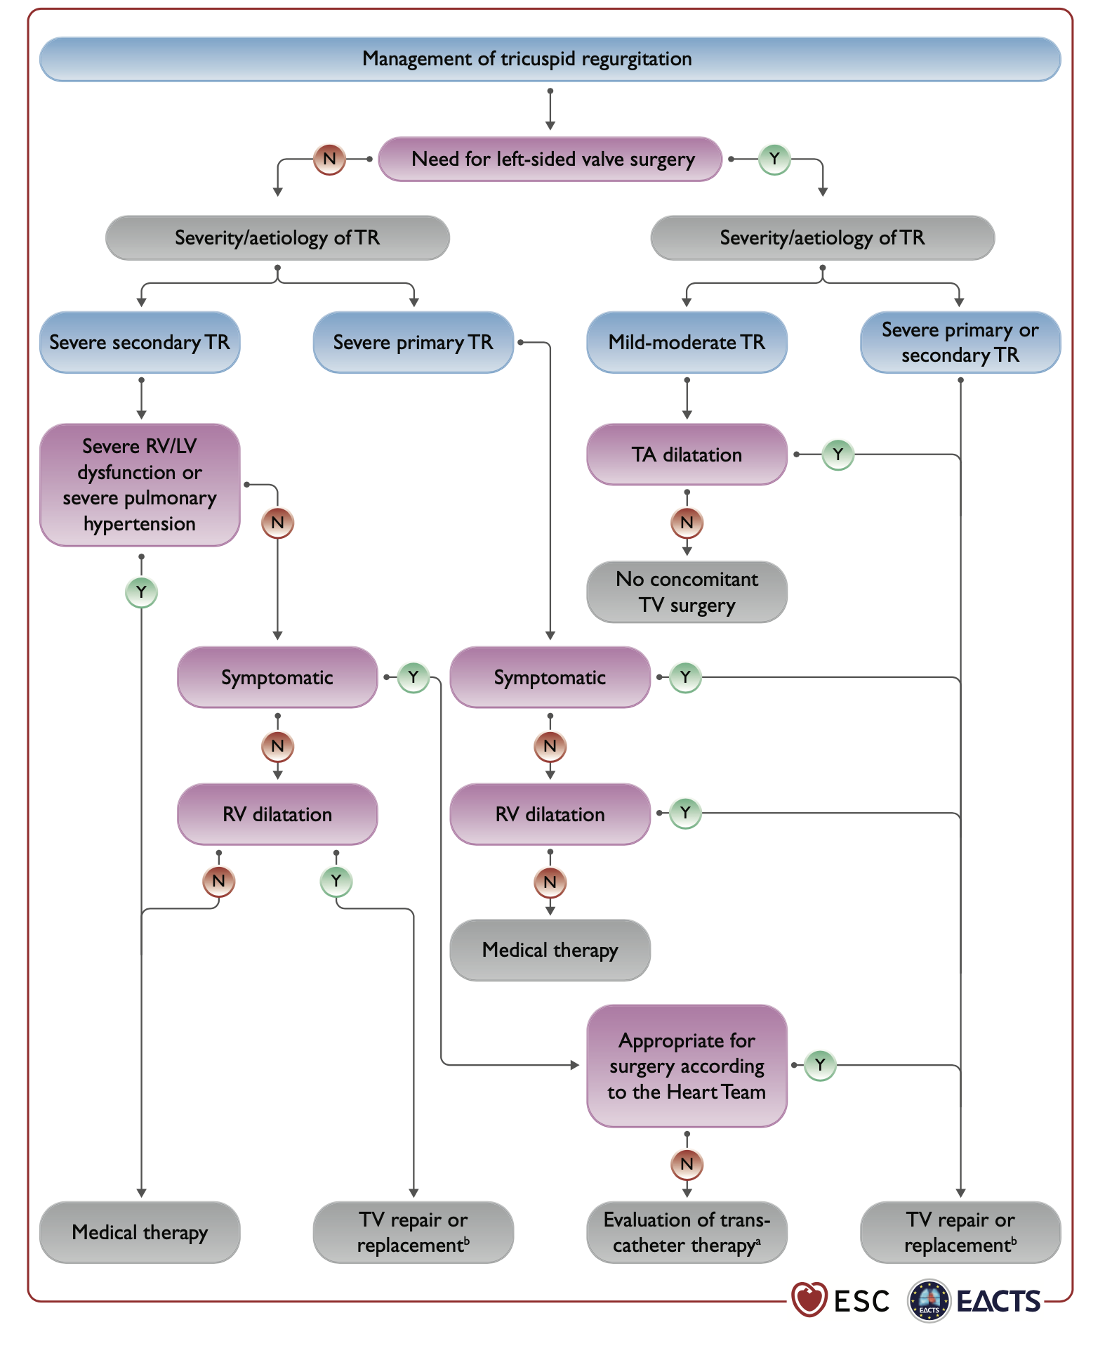

Transcatheter tricuspid valve interventions
Figure 2
2021 ESC/EACTS Guidelines recommendations for TR management.
Reproduced with permission from Vahanian et al. [17].
Nicola Buzzatti, Jean-Michel Juliard, Fabien Praz, Alec Vahanian, Azeem Latib,
Eric Brochet, Phalla Ou, Dominique Himbert, Mirjam Wild, Domenico Angellotti
©2025 Europa Group - All rights reserved.

