Slide 1


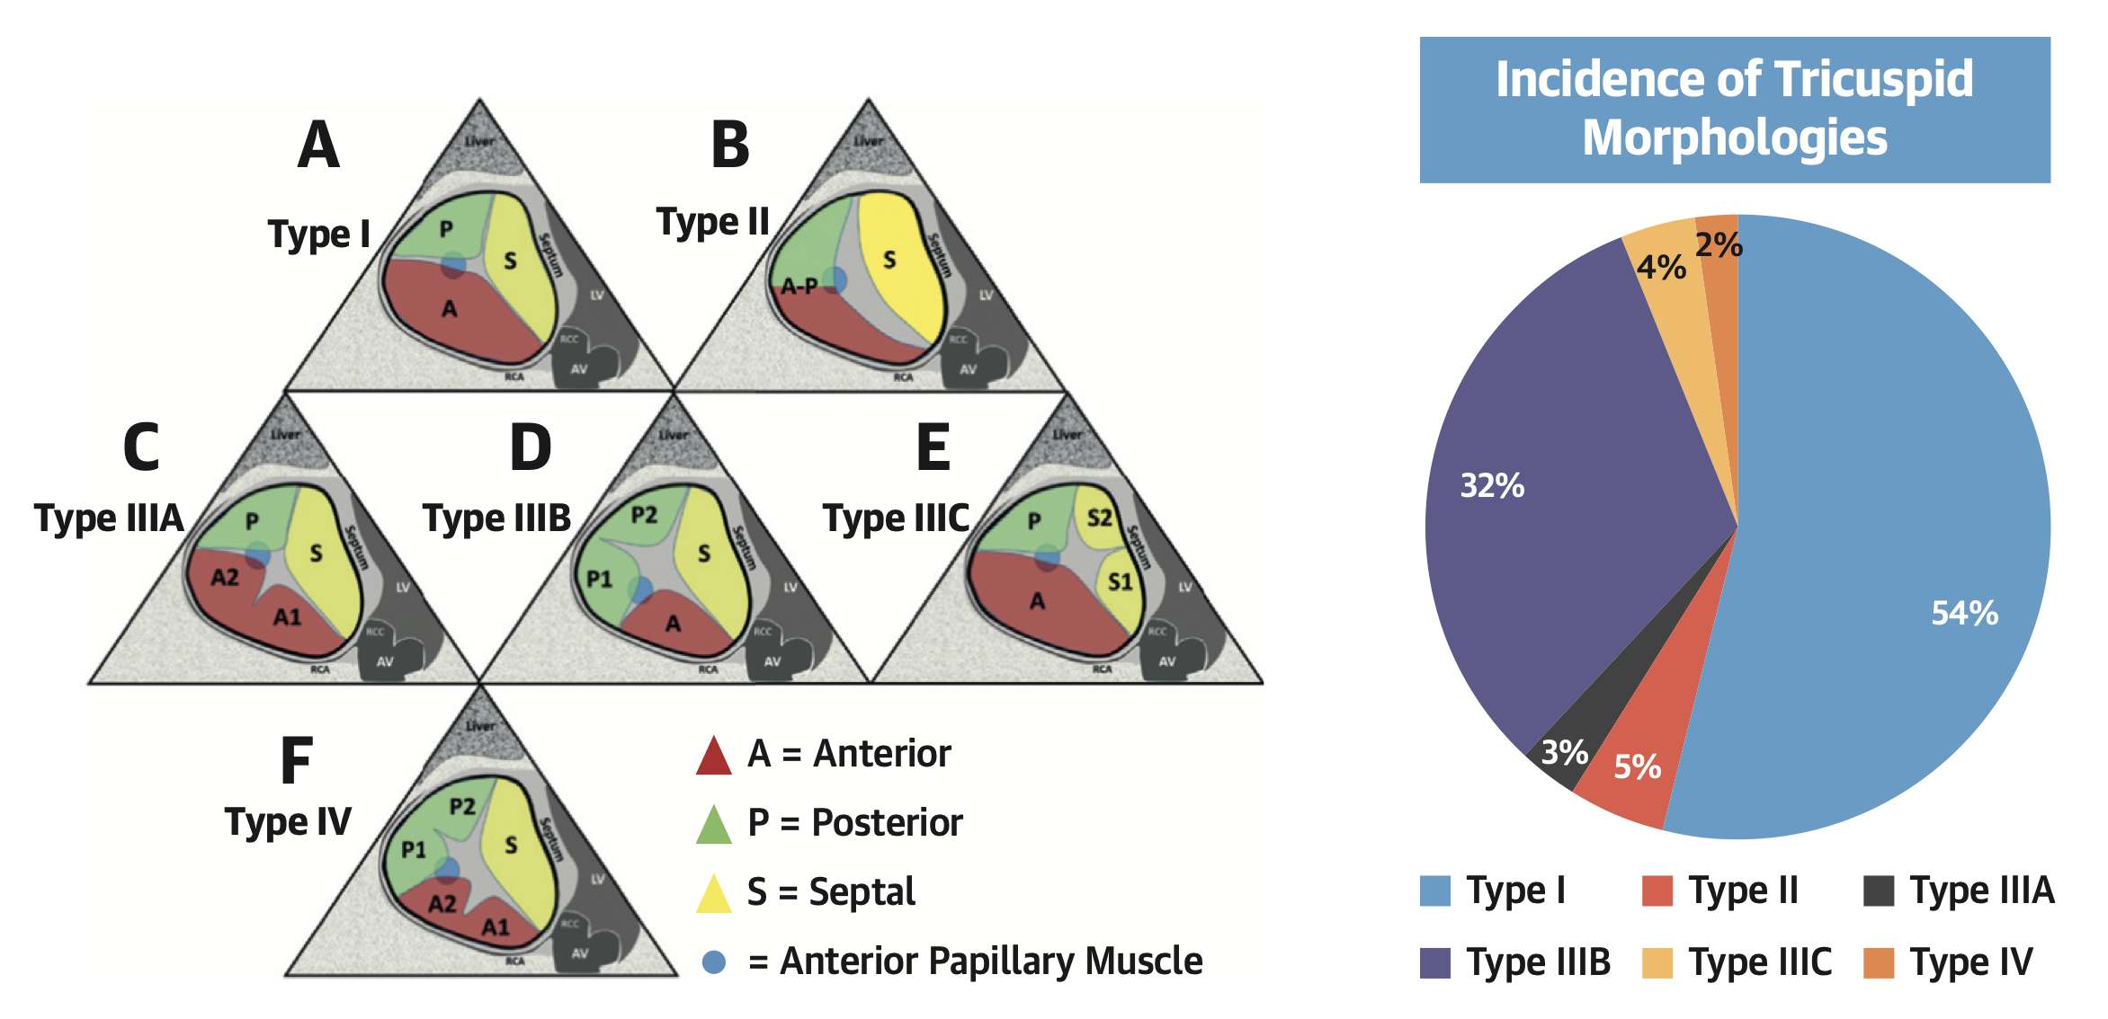

Transcatheter tricuspid valve interventions
Figure 3
Anatomical classification of the tricuspid valve based on leaflet morphology.
Various clefts, indentations, divisions of tricuspid leaflets are usually observed in clinical practice. Reproduced with permission from Hahn et al. [20].
Nicola Buzzatti, Jean-Michel Juliard, Fabien Praz, Alec Vahanian, Azeem Latib,
Eric Brochet, Phalla Ou, Dominique Himbert, Mirjam Wild, Domenico Angellotti
©2025 Europa Group - All rights reserved.

