Slide 1


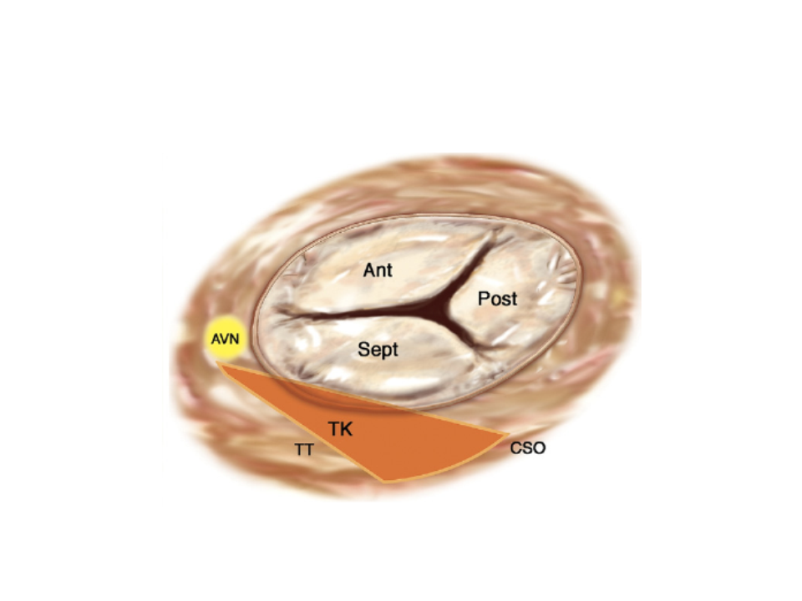

Transcatheter tricuspid valve interventions
Figure 4
Surgical anatomy of the tricuspid valve. The triangle of Koch (TK) is indicated by the orange area. Ant: anterior; AVN: atrioventricular node; CSO: coronary sinus orifice; Post: posterior; Sept: septal; TT: tendon of Todaro
Nicola Buzzatti, Jean-Michel Juliard, Fabien Praz, Alec Vahanian, Azeem Latib, Eric Brochet, Phalla Ou, Dominique Himbert, Mirjam Wild, Domenico Angellotti
©2025 Europa Group - All rights reserved.

