Slide 1


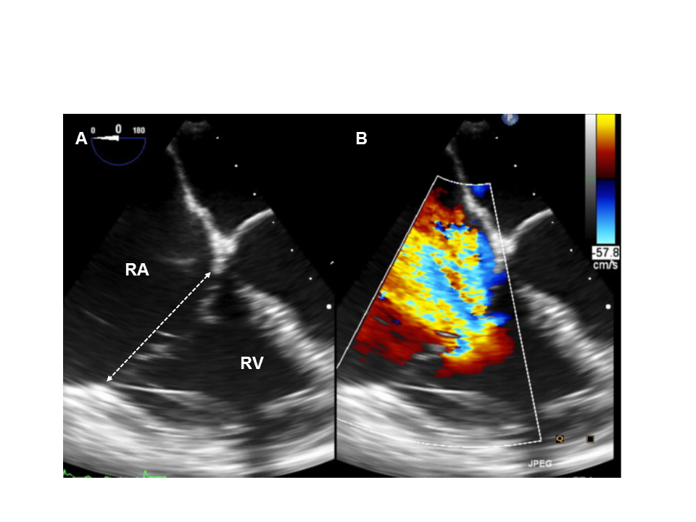

Transcatheter tricuspid valve interventions
Figure 5
Pre-procedural transoesophageal echocardiography (TOE) assessment of septolateral annular dimension (A) and tricuspid regurgitation (TR) (B).
Nicola Buzzatti, Jean-Michel Juliard, Fabien Praz, Alec Vahanian, Azeem Latib,
Eric Brochet, Phalla Ou, Dominique Himbert, Mirjam Wild, Domenico Angellotti
©2025 Europa Group - All rights reserved.

