Slide 1


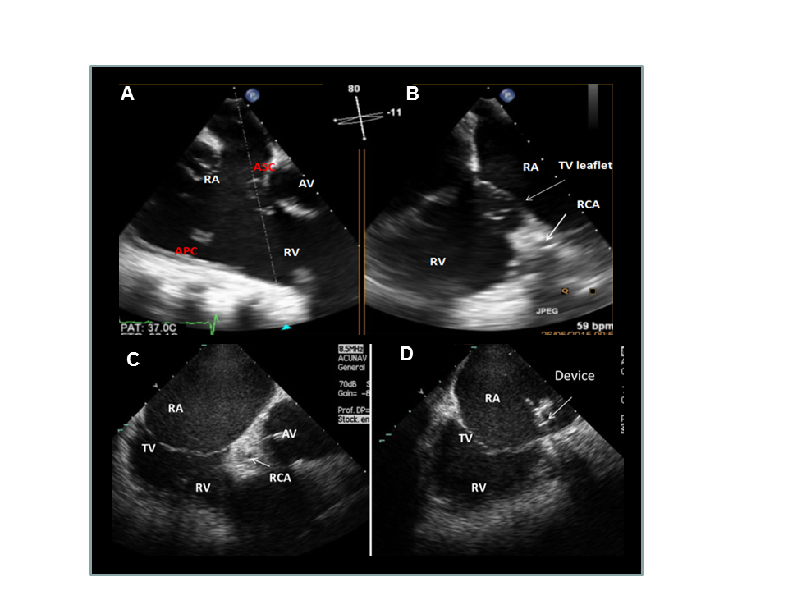

Transcatheter tricuspid valve interventions
Figure 7
xPlane 2D TOE imaging (A and B) and ICE imaging (C and D) during intervention. Identification of the target area on the anteroseptal (AS) commissure (A, B and C). Positioning of the catheter tip using ICE imaging (D). APC: anteroposterior commissure; ASC: anteroseptal commissure; AV: aortic valve; RA: right atrium; RCA: coronary artery; RV: right ventricle
Nicola Buzzatti, Jean-Michel Juliard, Fabien Praz, Alec Vahanian, Azeem Latib, Eric Brochet, Phalla Ou, Dominique Himbert, Mirjam Wild, Domenico Angellotti
©2025 Europa Group - All rights reserved.

