Slide 1


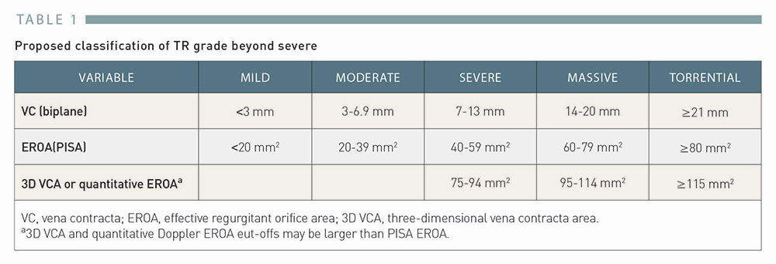

Transcatheter tricuspid valve interventions
Table 1
Proposed classification of TR grade beyond severe.
Adapted from Hahn et al. [27], with permission.
Nicola Buzzatti, Jean-Michel Juliard, Fabien Praz, Alec Vahanian, Azeem Latib,
Eric Brochet, Phalla Ou, Dominique Himbert, Mirjam Wild, Domenico Angellotti
©2025 Europa Group - All rights reserved.

