Slide 1


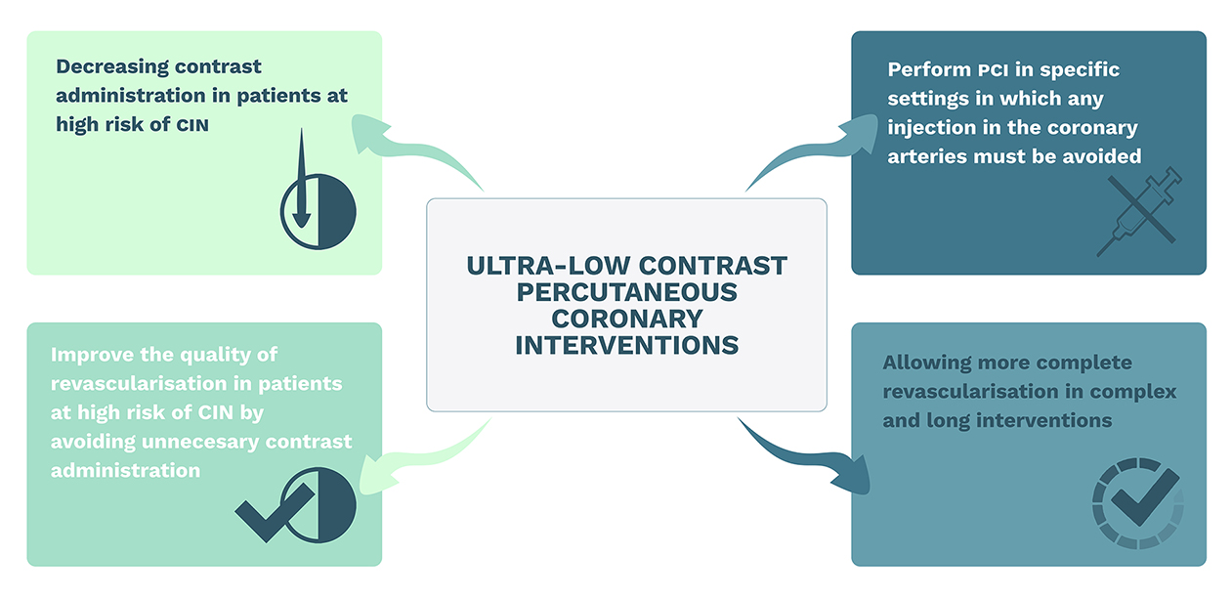

Use of ultra-low contrast techniques
in percutaneous coronary interventions
Figure 1
Main objectives of ultra-low contrast percutaneous coronary interventions. CIN: contrast-induced nephropathy; PCI: percutaneous coronary intervention
Alejandro Travieso, Breda Hennessey, Asad Shabbir, Adrian Jerónimo, Nieves Gonzalo, Javier Escaned
©2025 Europa Group - All rights reserved.

