Slide 1


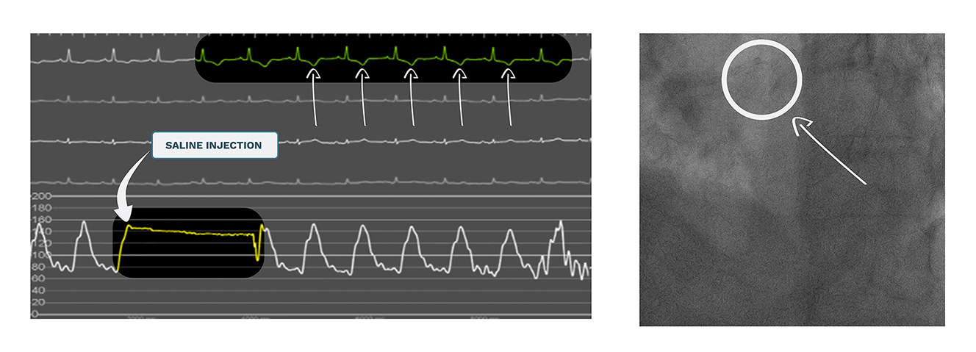

Use of ultra-low contrast techniques
in percutaneous coronary interventions
Figure 2
Ostium engagement and ECG changes due to saline injection. Panel A (left) shows ECG monitoring before and after the infusion of a bolus of saline (5-7 ml approx.). Immediately after the injection, negative T-waves can be seen in the ECG, confirming the adequate engagement of the guiding catheter into the coronary ostium (panel B, right). ECG: electrocardiogram
Alejandro Travieso, Breda Hennessey, Asad Shabbir, Adrian Jerónimo, Nieves Gonzalo, Javier Escaned
©2025 Europa Group - All rights reserved.

