Slide 1


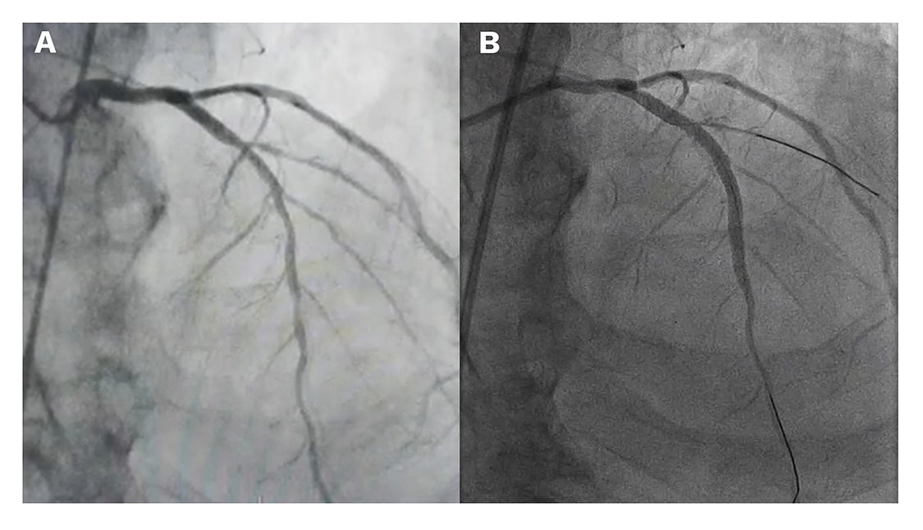
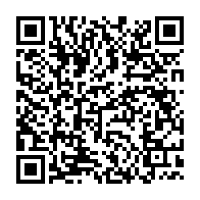
Use of ultra-low contrast techniques in percutaneous coronary interventions
Figure 3
Coronary angiograms obtained with normal contrast and diluted contrast. The left image (A) shows a conventional angiogram using 6 ml of contrast and 15 frames per second. The image on the right (B) shows an angiography of the same patient undergoing a scheduled ULCPCI procedure using 6 ml of diluted contrast (1:1 ratio with normal saline) and higher frame rate (30 frames per second). ULCPCI: ultra-low contrast percutaneous coronary intervention
Alejandro Travieso, Breda Hennessey, Asad Shabbir, Adrian Jerónimo, Nieves Gonzalo, Javier Escaned
©2025 Europa Group - All rights reserved.

