Slide 1


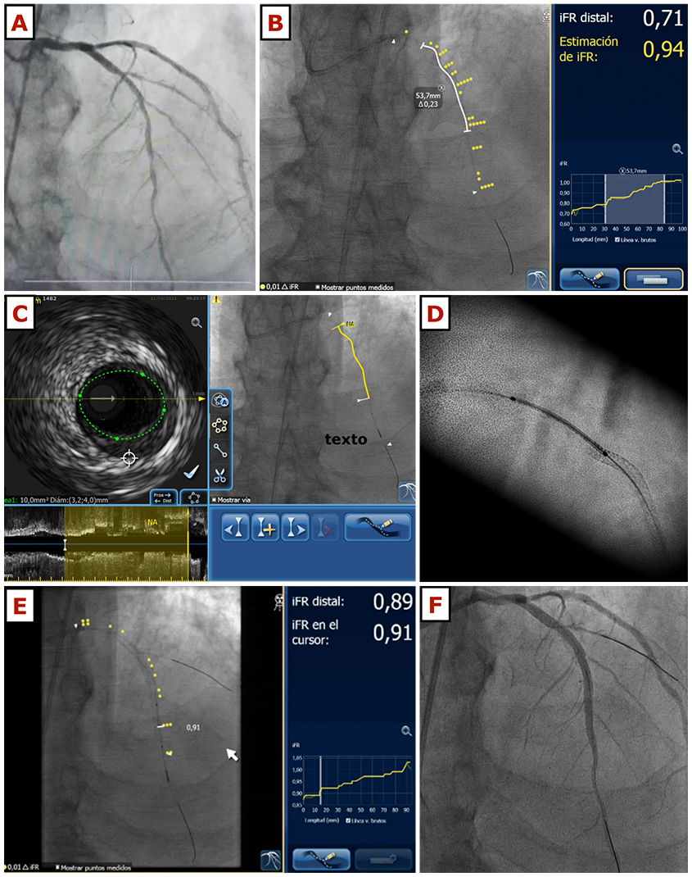
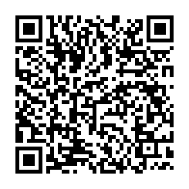
Use of ultra-low contrast techniques in percutaneous coronary interventions
Figure 4
This figure illustrates the case of a 72-year-old gentleman with cardiovascular risk factors including hypertension and insulin-dependent diabetes mellitus, with stage 4 chronic kidney disease and an eGFR of 22 ml/min/m2. He was admitted with congestive heart failure and the echocardiogram showed left ventricular systolic dysfunction with an ejection fraction of 36%, anterior hypokinesis and moderate mitral regurgitation. A coronary angiogram using 18 ml of contrast was performed, showing a long, severe lesion in the left anterior descending artery (panel A). The patient was scheduled for ULCPCI and after catheter engagement and wire navigation using the previous angiogram as a reference, iFR measurements confirmed the stenosis severity. iFR pullback was co-registered with the fluoroscopic image using the wire as the marker of the vessel position (panel B). Then, intravascular ultrasound pullback was also done and co-registered with fluoroscopy (panel C). After predilatation with a 2.75 x 10 mm cutting balloon, the first drug-eluting stent was placed distally (2.75 x 20 mm). Then, a second drug-eluting stent was implanted. For a precise visualisation of the correct overlap area, stent-enhancing techniques were used, and no contrast was needed before the second stent (3.5 x 28 mm) was implanted (panel D). Post-dilation was done using a 3.5 non-compliant balloon and then, a pressure wire pullback was repeated (panel E) showing an excellent physiological result (iFR 0.91). A final injection was done in order to exclude any significant complications (panel F), and the procedure was finished, having used 8 ml of contrast in total. eGFR: estimated glomerular filtration rate; iFR: instantaneous wave-free ratio; ULCPCI: ultra-low contrast percutaneous coronary intervention
Alejandro Travieso, Breda Hennessey, Asad Shabbir, Adrian Jerónimo, Nieves Gonzalo, Javier Escaned
©2025 Europa Group - All rights reserved.

