Slide 1


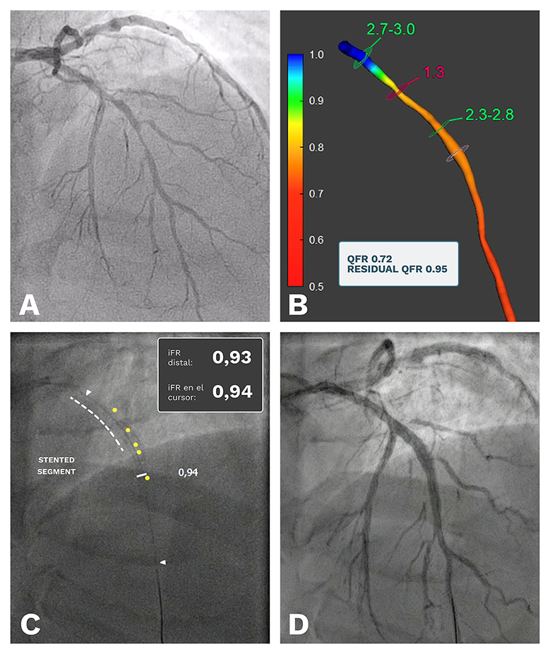

Use of ultra-low contrast techniques in percutaneous coronary interventions
Figure 5
A case example of the use of Quantitative Flow Ratio (QFR) in the setting of ULCPCI. Using a previous angiogram (panel A), an offline QFR calculation was performed, showing a positive result (QFR 0.72) with the major estimated pressure drop located in the proximal segment of the left anterior descending artery (LAD). The simulation of a stent in that portion of the vessel yielded a significant improvement in vessel physiology (residual QFR 0.95, panel B), so PCI for this segment was scheduled. Using ULCPCI techniques, a stent was placed in the proximal portion of the LAD and after implantation the pressure pullback and co-registration showed an iFR of 0.94, very similar to the predicted QFR result (panel C). The final angiogram showed a good result without complications, and the procedure was ended having used 6 ml of contrast media. iFR: instantaneous wave-free ratio; ULCPCI: ultra-low contrast percutaneous coronary intervention
Alejandro Travieso, Breda Hennessey, Asad Shabbir, Adrian Jerónimo, Nieves Gonzalo, Javier Escaned
©2025 Europa Group - All rights reserved.

