Slide 1


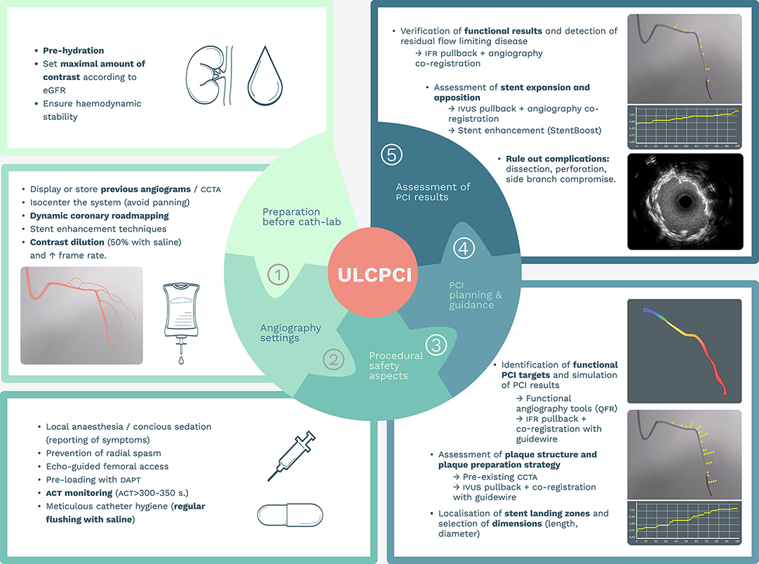
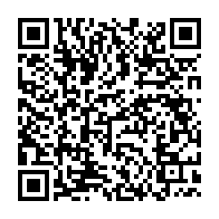
Use of ultra-low contrast techniques in percutaneous coronary interventions
Figure 6
Key steps in the planning of ultra-low contrast percutaneous coronary interventions. ACT: activated clotting time; CCTA: cardiac computed tomographic angiography; DAPT: dual antiplatelet therapy; eGFR: estimated glomerular filtration rate; iFR: instantaneous wave-free ratio. IVUS: intravascular ultrasound: PCI : percutaneous coronary intervention; QFR: quantitative flow ratio
Alejandro Travieso, Breda Hennessey, Asad Shabbir, Adrian Jerónimo, Nieves Gonzalo, Javier Escaned
©2025 Europa Group - All rights reserved.

