Slide 1


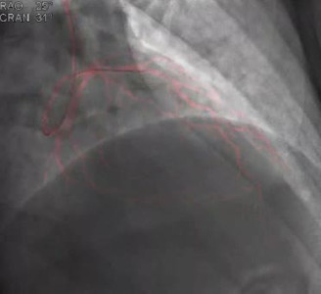

Use of ultra-low contrast techniques in percutaneous coronary interventions
Video 1
Use of dynamic coronary roadmap (DCR) for wire navigation.This is an example of how DCR displays a template of the coronary vessels generated from a previous angiogram. The overlapping image can help the wiring of the target vessel without the need for further contrast injections.
Alejandro Travieso, Breda Hennessey, Asad Shabbir, Adrian Jerónimo, Nieves Gonzalo, Javier Escaned
©2025 Europa Group - All rights reserved.

