Slide 1


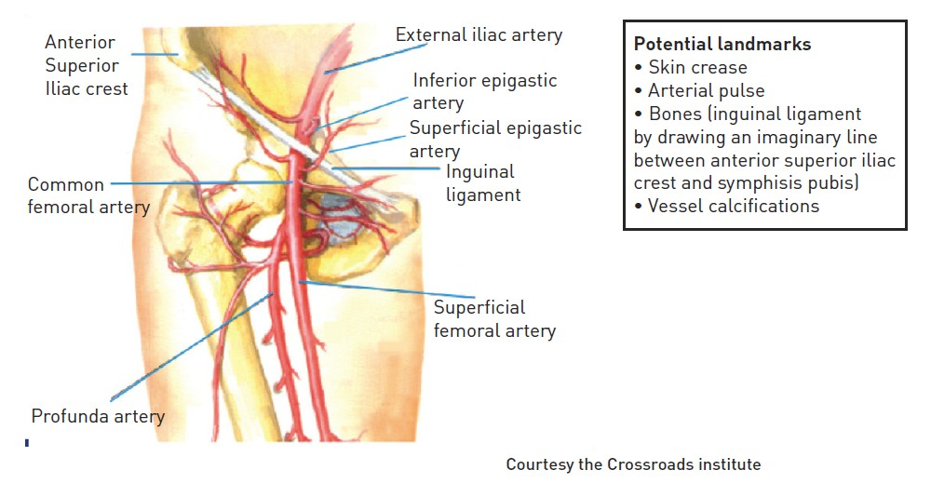

Vascular access
Figure 1
Femoral arterial anatomy and surface landmarks
Olivier Bertrand, David Meerkin
©2025 Europa Group - All rights reserved.

