Slide 1


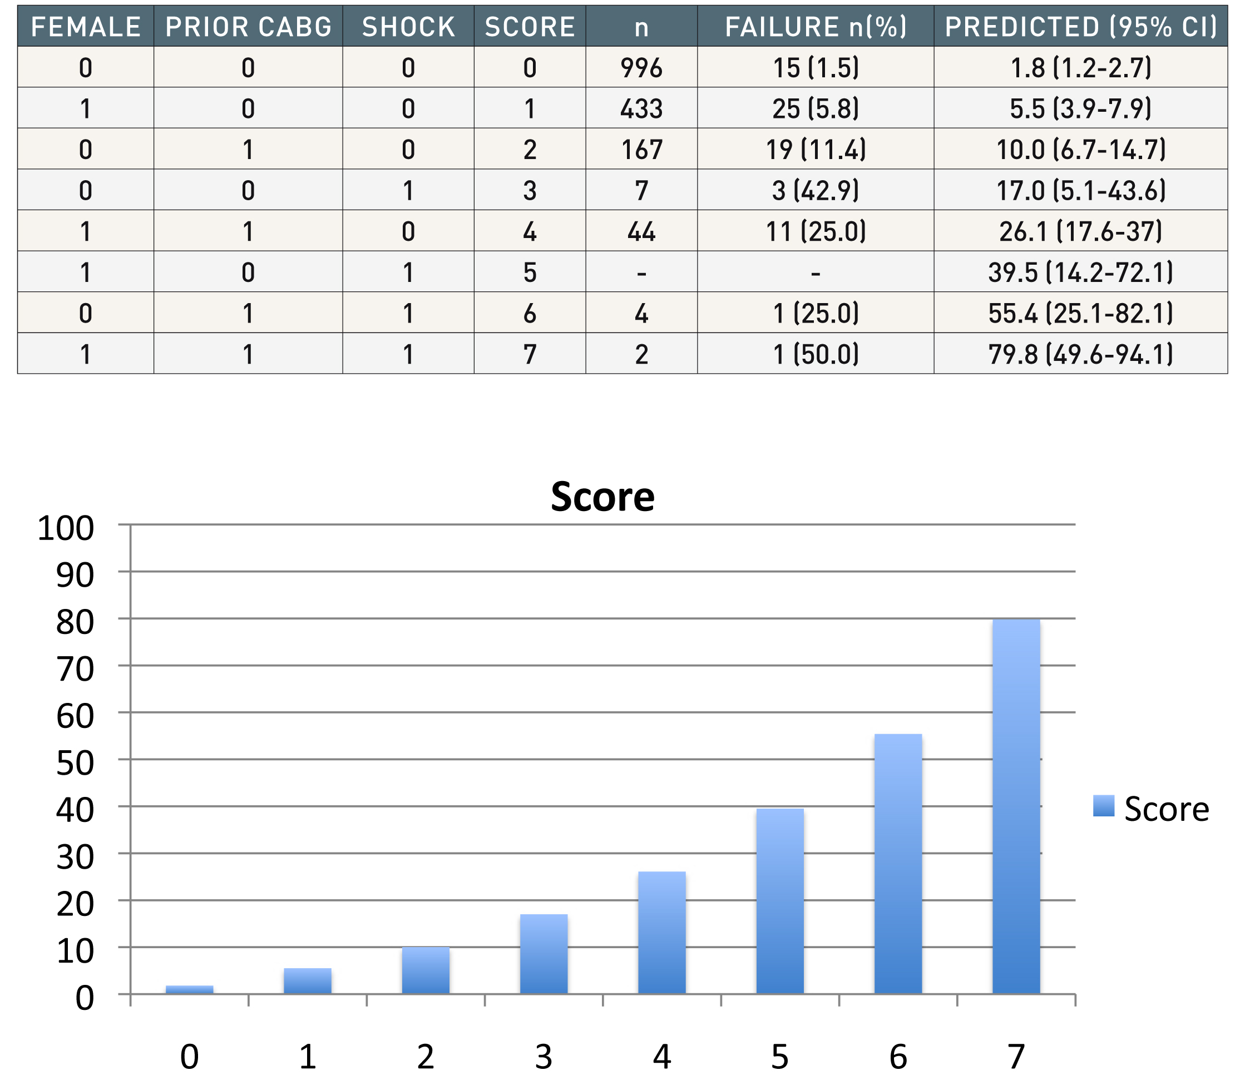

Vascular access
Figure 10C
Observed versus predicted radial PCI failure- : data not observed CI - confidence intervalsScore represents summation of the 3 variables listed. Female scores 1 point CABG scores 2 points Shock scores 3 pointsWhen more than one variable is observed an extra point is added
Olivier Bertrand, David Meerkin
©2025 Europa Group - All rights reserved.

