Slide 1


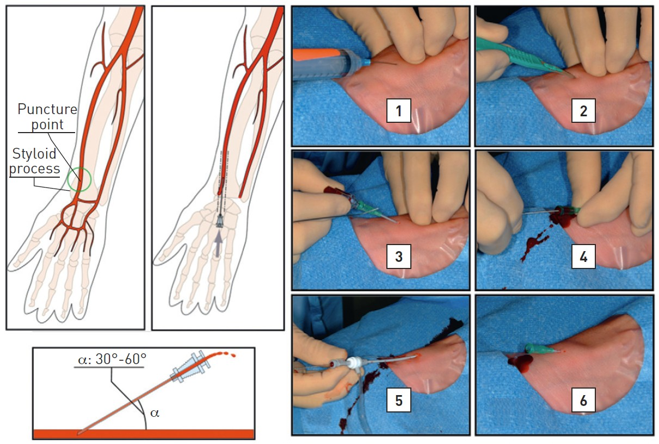

Vascular access
Figure 12
Radial punctureCourtesy Crossroads InstituteLeft-hand panelsArterial puncture should be made proximal to the flexor retinaculum at an angle of 30-60 degrees in the sagittalplane and from lateral to medial.Right-hand panels1. Local anaesthetic infiltration. 0.5-1ml is typically sufficient to both anaestetise and not obsure the underlying pulse.2. Skin incision made with a surgical blade3. \'\'Abocath\'\'-style cannula with flashback chamber inserted. WHen blood appears in this chamber this indicates that the needle has entered the vessel.4. Pulsatile flow indicating the cannula is in the central axis of the vessel.5. Sheath assembly inserted successfully.6. Sheath in placee.
Olivier Bertrand, David Meerkin
©2025 Europa Group - All rights reserved.

