Slide 1


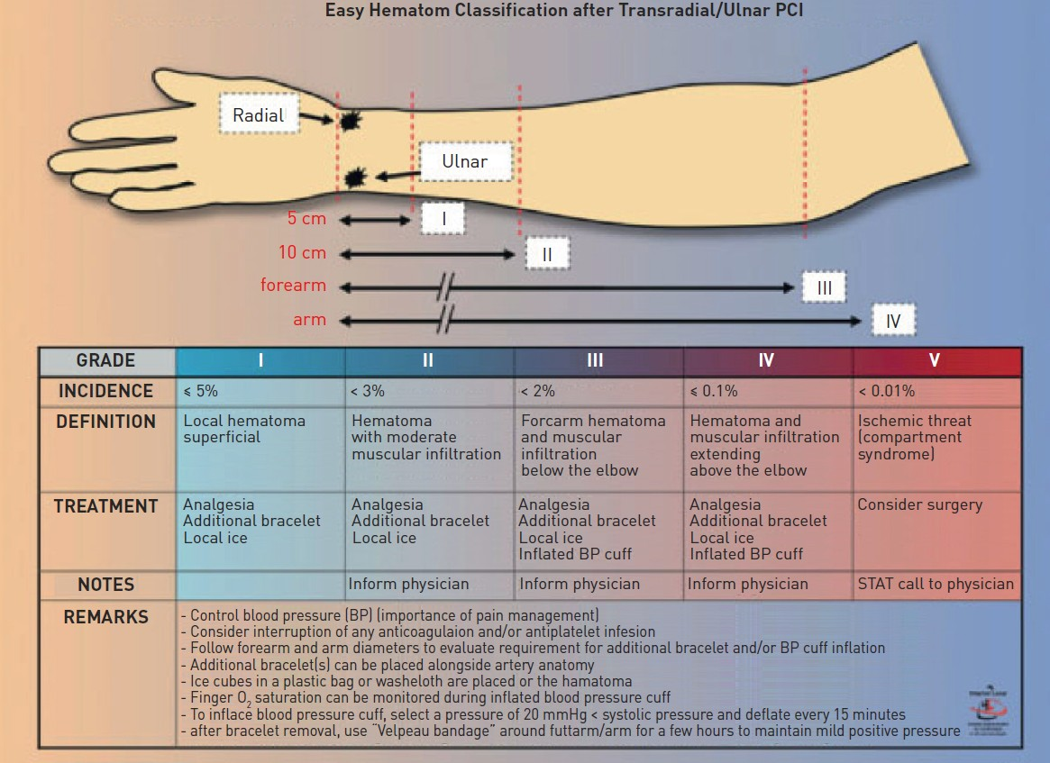

Vascular access
Figure 13
EASY haematoma classification after Transradial/Ulnar PCIGrade I and II are related to the puncture siteGrade III or higher indicates arterial injury and intramuscular extravasation. These grades must be managed aggressively in order to prevent compartment syndrome. [62]
Olivier Bertrand, David Meerkin
©2025 Europa Group - All rights reserved.

