Slide 1


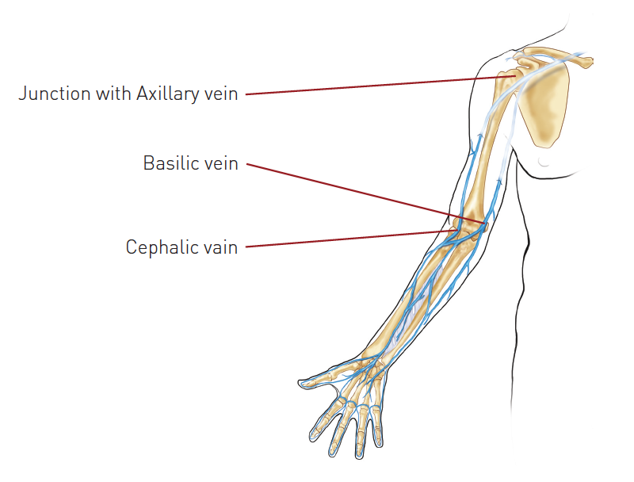

Vascular access
Figure 14
Upper limb venous access for right heart catheterisationThe Cephalic vein approach can be more challenging because of an oblique entry into the Axillary vein in the deltopectoral triangle.
Olivier Bertrand, David Meerkin
©2025 Europa Group - All rights reserved.

