Slide 1


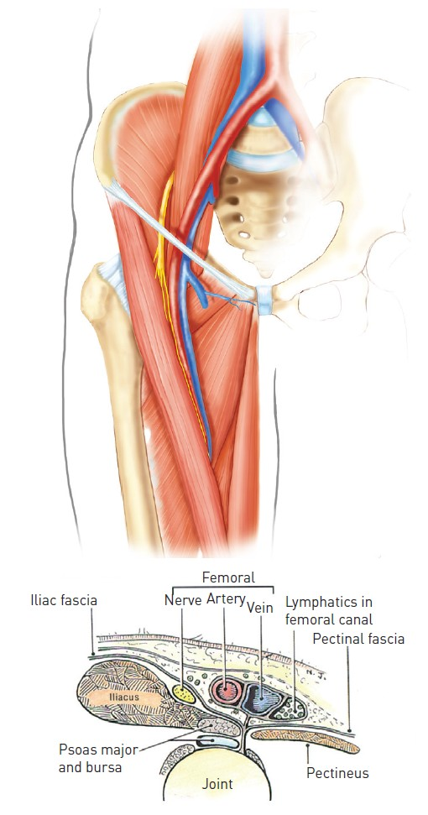

Vascular access
Figure 2A and 2B
The Femoral triangleUpper panel: sagittal view - Lower panel: transverse viewThe borders of the femoral triangle are the inferior border of the inguinal ligament, lateral border of the adductor longus, and medial border of sartorius.
Olivier Bertrand, David Meerkin
©2025 Europa Group - All rights reserved.

