Slide 1

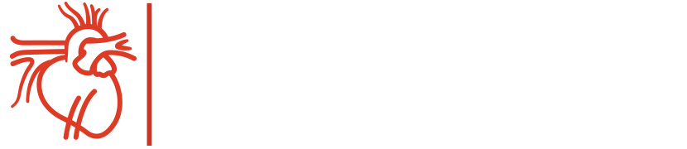
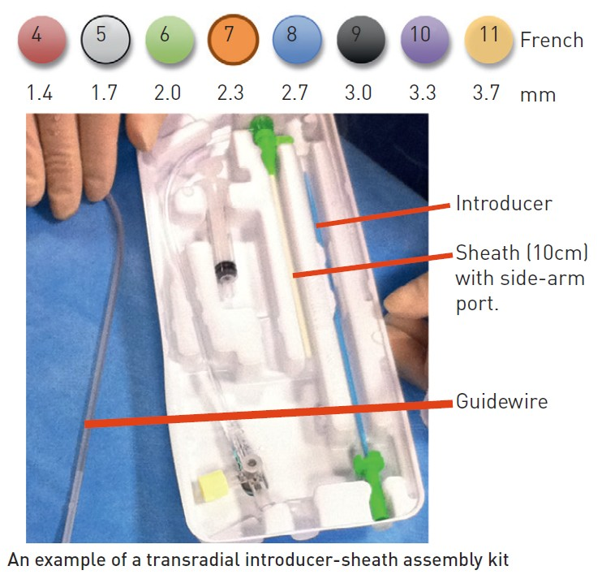

Vascular access
Figure 4
Sheath size (Colour-coded French scale with internal diameter)Vascular sheaths are used to facilitate equipment passage and catheter exchange as well as avoiding trauma during exchange manoeuvres. They consist of a Teflon tube with a haemostatic valve and side-arm port for pressure measurement and drug administration.Once a vascular puncture has been made a sheath specific guidewire is introduced into the arterial/venous central lumen and a sheath/dilator assembly is passed over it and into the vessel. The guidewire and dilator are then removed.
Olivier Bertrand, David Meerkin
©2025 Europa Group - All rights reserved.

