Slide 1


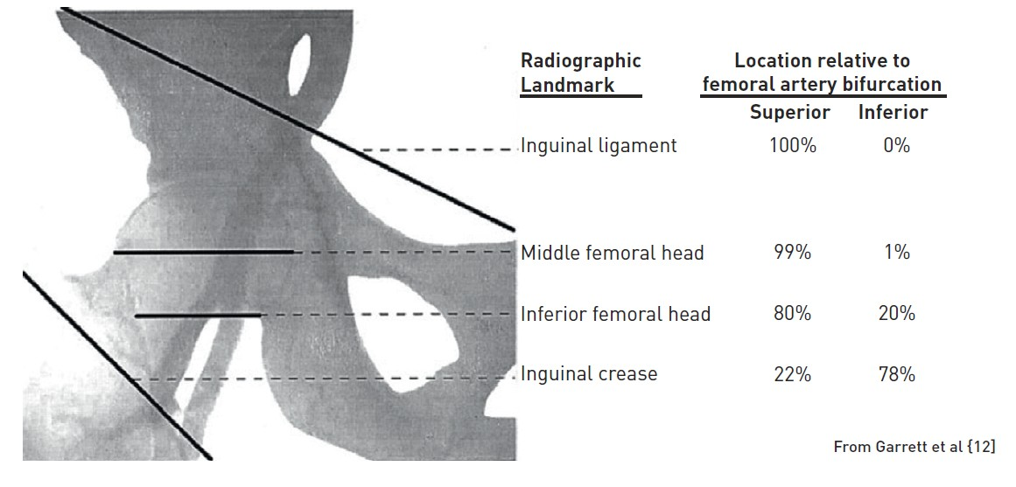

Vascular access
Figure 5
Femoral radiographic anatomy
Olivier Bertrand, David Meerkin
©2025 Europa Group - All rights reserved.

