Slide 1


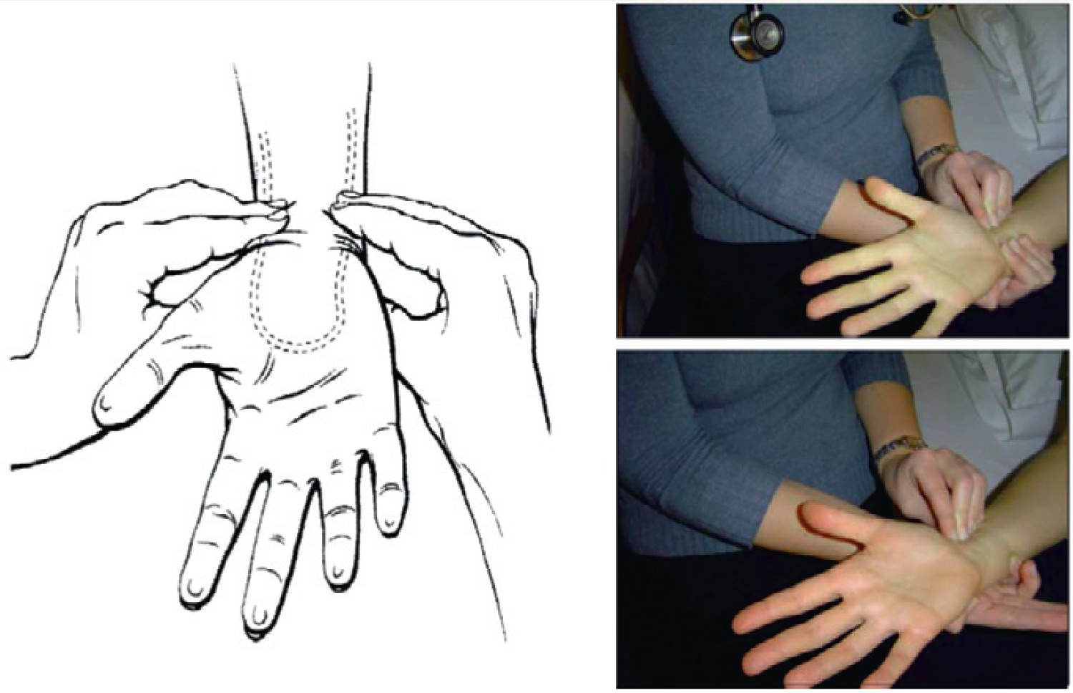

Vascular access
Figure 8
Compression of both radial and ulnar arteries and followed by release of compression from the ulnar artery
Olivier Bertrand, David Meerkin
©2025 Europa Group - All rights reserved.

