Slide 1


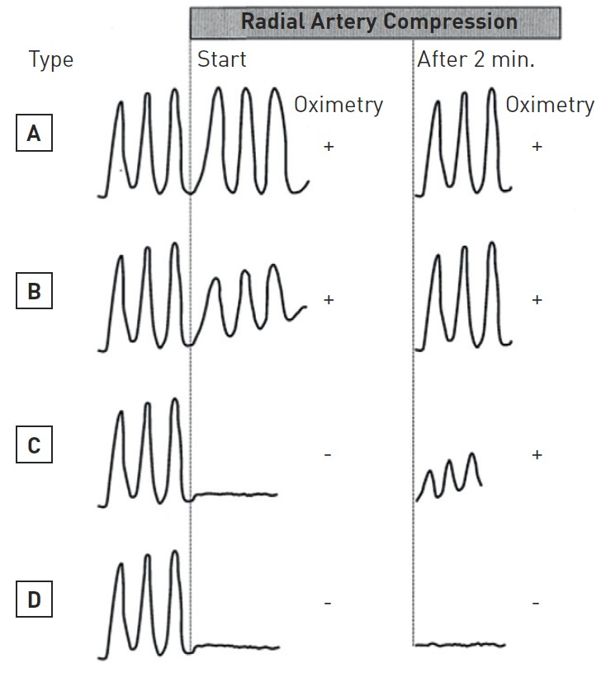

Vascular access
Figure 9
Oximetry-plethysmographyThis uses the principle of Allen to test for the functional integrity of the palmar arterial arches. Instead of visually assessing for adequate collateral refilling of the skin, a pulse oximeter over the thumb displays the digital arterial waveform and arterial saturation. The test is carried out over 2 minutes.A indicates Normal waveform and oximetry initially and at 2 minutes(Satisfactory palmar circulation)B indicates a reduced but detectable waveform and normal oximetry and normal waveform and oximetry at 2 minutes. (Satisfactory palmar circulation after recruitment of collaterals)C indicates an absence of waveform and reduced/absent saturation reading with return of waveform and normal oximetry at 2 minutes.(Satisfactory palmar circulation after recruitment of collaterals)D indicates absent waveform and oximetry throughout(Inadequate palmar collateral circulation).From Barbeau et al. [39]
Olivier Bertrand, David Meerkin
©2025 Europa Group - All rights reserved.

