Slide 1


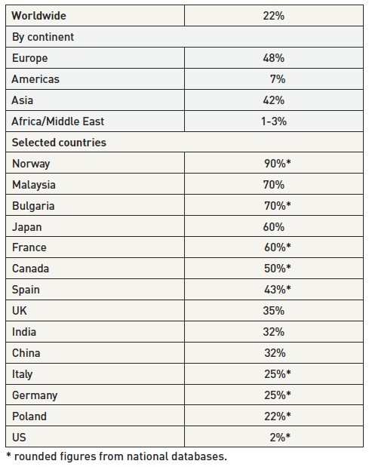

Vascular access
Table 1
Uptake of transradial procedures (2010 data) [46]
Olivier Bertrand, David Meerkin
©2025 Europa Group - All rights reserved.

