Slide 1


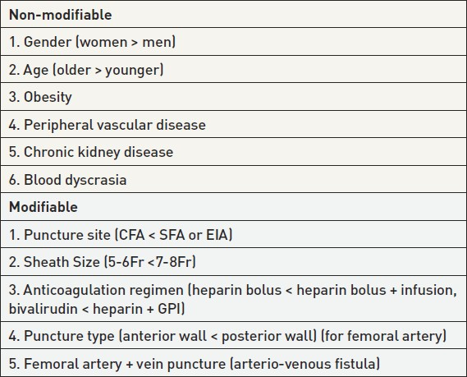

Vascular access
Table 2
Factors associated with vascular complications
Olivier Bertrand, David Meerkin
©2025 Europa Group - All rights reserved.

