Slide 1


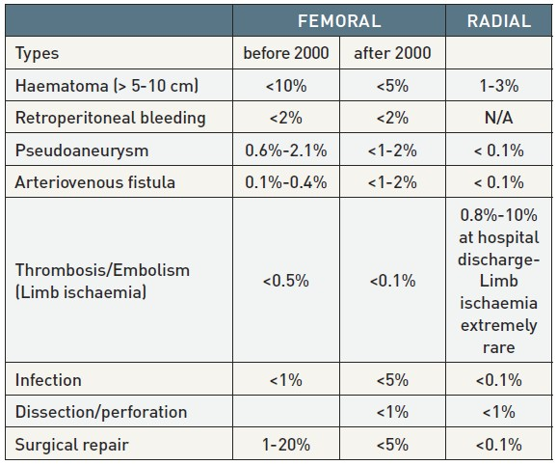

Vascular access
Table 3
Complications
Olivier Bertrand, David Meerkin
©2025 Europa Group - All rights reserved.

