Slide 1


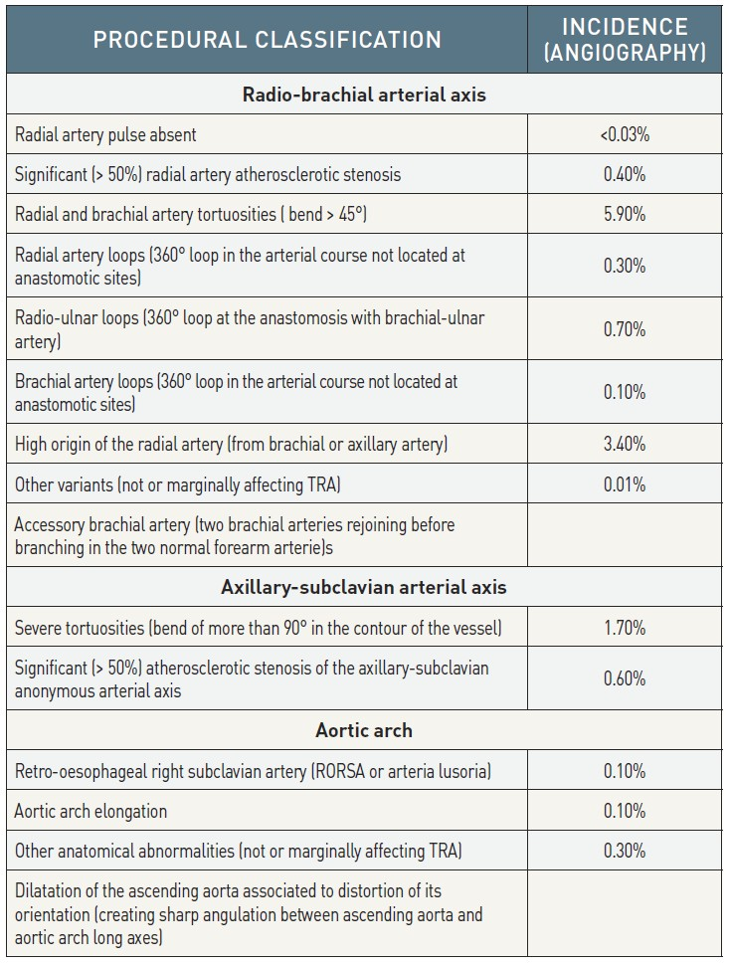

Vascular access
Table 4
Upper limb arterial anomalies [50]
Olivier Bertrand, David Meerkin
©2025 Europa Group - All rights reserved.

