Slide 1


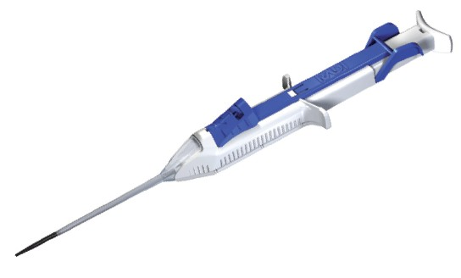
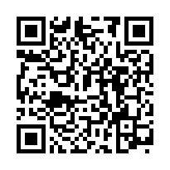
Vascular closure
Figure 10
FemoSeal™ device.
Marie-Claude Morice, Maya Riche
©2025 Europa Group - All rights reserved.

