Slide 1


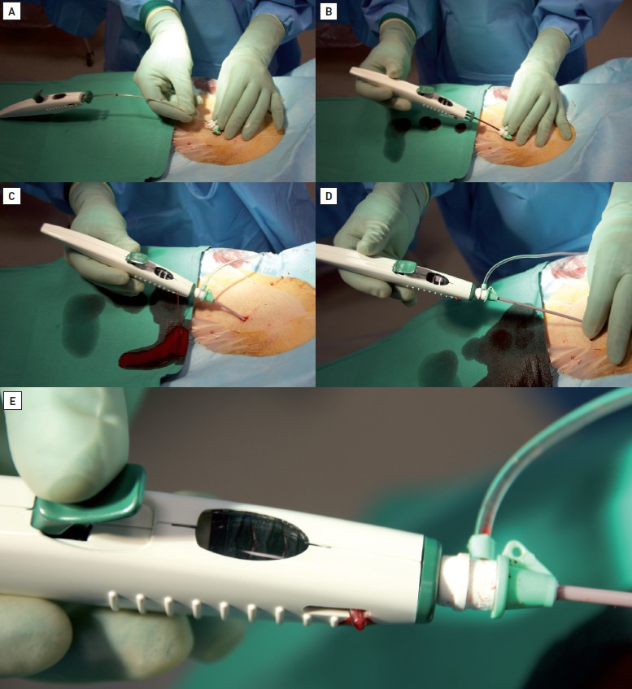

Vascular closure
Figure 12
Deployment technique for ExoSeal® 1. The system is introduced directly into the sheath until the black marker is reached (Figure 12A and Figure 12B).2. The system is clipped into the sheath. This is followed by the appearance of a pulsatile flow of blood through the bleed-back system (Figure 12C).3. Withdraw the system slowly watching the two black and white markers on the upper surface of the system. 4. Initially the flow of blood stops (Figure 12D), then the black and white marker turns entirely black (Figure 12E).5. The system is released by pressing the green button.6. Finish with a non-occlusive dressing for 2-3 minutes.
Marie-Claude Morice, Maya Riche
©2025 Europa Group - All rights reserved.

